Slide 1



Safety and Cardiovascular Efficacy of Bococizumab Among 27,438 High Risk Patients
The SPIRE 1 and SPIRE 2 Cardiovascular Outcome Trials
Lipid Lowering Efficacy of Bococizumab Among 4,449 High Risk Patients
The SPIRE Lipid Lowering Trials
Paul M Ridker, MD, MPH
Brigham and Women’s Hospital, Boston MA
on behalf of the worldwide investigators and participants in the
Studies of PCSK9 Inhibition and the Reduction in vascular Events (SPIRE)
Bococizumab Development Program
Ridker ACC 2017

Slide 2
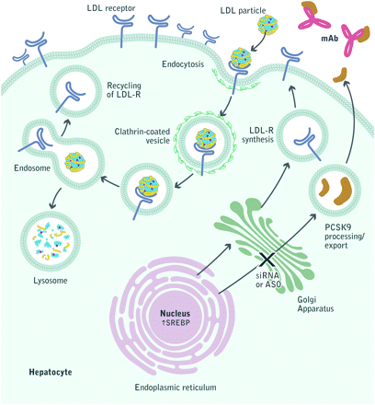
Monoclonal Antibodies to PCSK9 and Recycling of the LDL Receptor: Cardiovascular Outcomes Trials
Evolocumab (Amgen)
FOURIER
NCT 01764633
Alirocumab (Sanofi/Regeneron)
ODYSSEY
NCT 01663402
Bococizumab (Pfizer)
SPIRE-1, SPIRE-2
NCT 01975376
NCT 01975389
Ridker ACC 2017

Slide 3
The SPIRE Bococizumab Clinical Development Program
SPIRE (Studies of PCSK9 Inhibition and
the Reduction of Vascular Events) N = 31,887
SPIRE Lipid Lowering Trials (N=4,449)
SPIRE CV Outcome Trials (N=27,438)
SPIRE HR (n = 711)
On maximally
tolerated statin
High risk of CV event
LDL-C ≥70 mg/dL
SPIRE LDL (n = 2,139)
On maximally
tolerated statin
High risk of CV event
LDL-C ≥70 mg/dL
SPIRE-1 (n=16,817)
High Risk Primary and Secondary Prevention
LDL-C >70 mg/dL
on highly effective statin
(or partially statin intolerant)
SPIRE-2 (n=10,621)
High Risk Primary and Secondary Prevention
LDL-C ≥100 mg/dL
on highly effective statin
(or statin intolerant)
SPIRE FH (n = 370)
HeFH (genetic diagnosis or Simon Broome Criteria),
LDL >70 mg/dl
SPIRE LL (n = 746)
On statin High / very high
risk of CV event
LDL-C ≥100 mg/dL
SPIRE SI (n = 184)
Statin intolerant
LDL-C ≥70 mg/dL
SPIRE AI (n = 299)
    Autoinjector
    Hyperlipidemia
Ridker et al, Am Heart J 2016;178:135-144
Ridker ACC 2017

Slide 4
The Six SPIRE Lipid Lowering Trials (N=4,449)
Bococizumab 150 mg SC Q2 Weeks
+ maximally tolerated statin
Screen
4 weeks
R
12 week and 52 week
Change in Lipid Levels
Placebo SC Q2 Weeks
+ maximally tolerated statin
Randomize
Treatment Period
(52 weeks)
Safety follow-up
(6 weeks)
The SPIRE 1 and SPIRE 2 Cardiovascular Outcome Trials (N = 27,438)
Patients with or at high risk for cardiovascular events
SPIRE-1: LDLC >70 mg/dL or non-HDLC >100mg/dL
SPIRE-2: LDLC >100 mg/dL or non-HDLC >130mg/dL
Bococizumab 150 mg SC Q2 Weeks
+ maximally tolerated statin
Pre-screen
≤ 30 days
Screen
≤14 days
Run-in
3 visits
R
CV Events*
Placebo SC Q2 Weeks
+ maximally tolerated statin
Randomize
SPIRE-1 (N=16,817)
SPIRE-2 (N=10,621)
Pre-screening, Screening, and Three Run-in Visits
Treatment Period
(>2 years)
Safety follow-up
(6 weeks)
*Nonfatal myocardial infarction, nonfatal stroke, hospitalization for unstable angina requiring urgent
revascularization, or cardiovascular death
Ridker ACC 2017

Slide 5
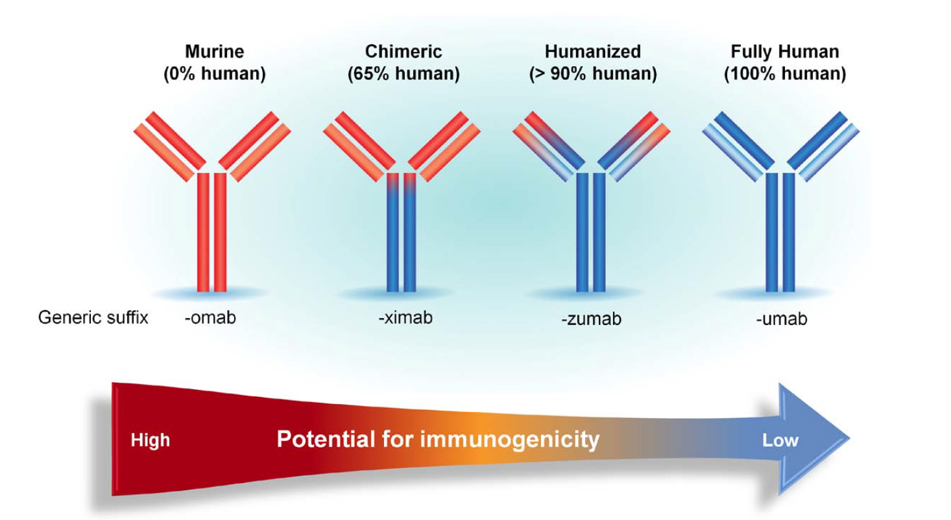
Evolution and Humanization of Therapeutic Monoclonal Antibodies
Tositumomab
(Bexxar)
Abciximab
(ReoPro)
Infliximab
(Remicade)
Rituximab
(Rituxan)
Bococizumab
Tocilizumab
(Actemra)
Evolocumab
(Repatha)
Alirocumab
(Praluent)
Canakinumab
(Ilaris)
Adapted from Foltz IN, Karow M, Wasserman SM. Circulation 2013; 127:2222-2230.
Ridker ACC 2017

Slide 6
The SPIRE Bococizumab Lipid Lowering Trials :
Baseline Clinical Characteristics
Characteristic | All Trials (N=4449) | SPIRE-HR (N=711) | SPIRE-LDL (N=2139) | SPIRE-FH (N=370) | SPIRE-LL (N=746) | SPIRE-SI (N=184) | SPIRE-AI (N=299)
Age (years) | 61.3 | 61.3 | 62.0 | 56.1 | 61.6 | 63.9 | 60.0
Female (%) | 43.7 | 37.4 | 40.6 | 41.9 | 44.2 | 53.8 | 45.8
Diabetes (%) | 53.3 | 49.4 | 62.9 | 20.3 | 56.4 | 24.5 | 44.1
FH (%) | 12.1 | 7.2 | 1.9 | 100.0 | 7.0 | 10.9 | 1.3
Statin Use (%) | 99.8* | 100.0 | 99.7 | 99.5 | 99.9 | 0.0 | 100.0
LDLC (mg/dL) | 122 | 115 | 112 | 147 | 136 | 174 | 112
Apo B (mg/dL) | 99 | 95 | 93 | 114 | 107 | 129 | 90
TG (mg/dL) | 145 | 138 | 147 | 124 | 168 | 166 | 120
Lp(a) (mg/dL) | 22 | 23 | 21 | 29 | 23 | 14 | NA
hsCRP (mg/L) | 1.8 | 1.6 | 2.0 | 0.9 | 2.2 | NA | NA
*Does not include SPIRE-SI
Ridker ACC 2017

Slide 7
The SPIRE Bococizumab Lipid Lowering Trials :
Large Reductions in LDLC with PCSK9 inhibition at 12 weeks
Percent Reduction in LDLC
55.2 % reduction in LDLC at 12 weeks
12 weeks, 150 mg
12 weeks, 75 mg
52 weeks, 150 mg
26 weeks, 150 mg
Ridker ACC 2017

Slide 8
The SPIRE Bococizumab Lipid Lowering Trials :
Unanticipated Attenuation of LDLC Reductions at 52 weeks
Percent Reduction in LDLC
55.2 % reduction in LDLC at 12 weeks
42.5 % reduction in LDLC at 52 weeks
12 weeks, 150 mg
12 weeks, 75 mg
52 weeks, 150 mg
26 weeks, 150 mg
Ridker ACC 2017

Slide 9
The SPIRE Bococizumab Lipid Lowering Trials :
Unanticipated Attenuation of Efficacy for All Lipid Parameters at 52 weeks
Percent Reduction
12 weeks, 150 mg
52 weeks, 150 mg
Ridker ACC 2017

Slide 10
The SPIRE Bococizumab Lipid Lowering Trials :
Development of Antidrug Antibodies (ADAs) and Attenuation of LDL Response Over Time
Placebo
ADA > 1:5,674 (1 in 20)
ADA > 1:1,176 (1 in 6)
LDL Cholesterol (mg/dL)
ADA < 1:1,176
ADA negative
44%
45%
46%
48%
50
38%
39%
36%
31%
30%
ADA Positive (%)
21%
21%
25
5%
5%
0
EOS
Weeks
Ridker ACC 2017

Slide 11
The SPIRE Bococizumab Lipid Lowering Trials :
Impact of Antidrug Antibodies (ADAs) on Plasma Bococizumab Concentration Over Time
ADA titer-dependent reductions in bococizumab concentration is likely
due to increased target-mediated clearance of unbound bococizumab
and accelerated clearance of ADA bound bococizumab.
Bococizumab concentration (mcg/mL)
ADA negative
ADA < 1:1,176
ADA > 1:1,176 (1 in 6)
ADA > 1:5,674 (1 in 20)
Weeks
Ridker ACC 2017

Slide 12
The SPIRE Bococizumab Lipid Lowering Trials :
Wide Individual Variation in Percent Change in LDLC at 52 Weeks with Bococizumab,
Even Among Those Who Are Antidrug Antibody Negative*
52 weeks
ADA negative
(N=780)
* Analysis excludes non-compliant participants
Ridker ACC 2017

Slide 13
On the basis of the completed SPIRE Lipid Lowering trials, the sponsor elected on November 1, 2016 to discontinue further development of bococizumab.
As a consequence of the data in the SPIRE Lipid Lowering trials, the sponsor elected to prematurely stop the ongoing SPIRE-1 and SPIRE-2 outcome trials which had, at that time, randomized 27,438 patients worldwide.
That decision was made with no knowledge by the sponsor or the investigators of any unblinded data within the SPIRE-1 or SPIRE-2 trials.
Impact of the SPIRE Lipid Lowering Trials on the SPIRE-1 and SPIRE-2 Cardiovascular Outcomes Trials
Ridker ACC 2017

Slide 14
The Six SPIRE Lipid Lowering Trials (N=4,449)
Bococizumab 150 mg SC Q2 Weeks
+ maximally tolerated statin
Screen
4 weeks
R
12 week and 52 week
Change in Lipid Levels
Placebo SC Q2 Weeks
+ maximally tolerated statin
Randomize
Treatment Period
(52 weeks)
Safety follow-up
(6 weeks)
The SPIRE 1 and SPIRE 2 Cardiovascular Outcome Trials (N = 27,438)
Patients with or at high risk for cardiovascular events
SPIRE-1: LDLC >70 mg/dL or non-HDLC >100mg/dL
SPIRE-2: LDLC >100 mg/dL or non-HDLC >130mg/dL
Bococizumab 150 mg SC Q2 Weeks
+ maximally tolerated statin
Pre-screen
≤ 30 days
Screen
≤14 days
Run-in
3 visits
R
CV Events*
Placebo SC Q2 Weeks
+ maximally tolerated statin
Randomize
SPIRE-1 (N=16,817)
SPIRE-2 (N=10,621)
Pre-screening, Screening, and Three Run-in Visits
Treatment Period
(>2 years)
Safety follow-up
(6 weeks)
*Nonfatal myocardial infarction, nonfatal stroke, hospitalization for unstable angina requiring urgent
revascularization, or cardiovascular death
Ridker ACC 2017

Slide 15
The SPIRE-1 and SPIRE-2 Cardiovascular Outcomes Trials :
Baseline Clinical Characteristics
Characteristic | SPIRE-1 Bococizumab (N=8408) | SPIRE-1 Placebo (N=8409) | SPIRE-2 Bococizumab (N=5212) | SPIRE-2 Placebo (N=5309)
Age (years) | 63.3 | 63.3 | 62.2 | 62.6
Female (%) | 26.3 | 26.5 | 34.1 | 35.1
Diabetes (%) | 48.3 | 47.4 | 47.8 | 46.1
Smokers (%) | 22.8 | 23.0 | 27.7 | 26.6
FH (%) | 1.7 | 1.8 | 7.0 | 7.6
Statin Use (%) | 99.1 | 99.2 | 83.2 | 83.1
Primary Prevention (%) | 13.0 | 13.8 | 18.9 | 18.5
LDLC (mg/dL) | 94 | 94 | 134 | 133
Apo B (mg/dL) | 80 | 80 | 106 | 106
TG (mg/dL) | 124 | 125 | 157 | 154
Lp(a) (mg/dL) | 19 | 19 | 19 | 20
hsCRP (mg/L) | 1.8 | 1.7 | 2.3 | 2.3
Absolute risk (MACE+)* | 3.02 per 100 person-years |  | 4.19 per 100 person-years
* Placebo group event rate
Ridker ACC 2017

Slide 16
The SPIRE 1 and SPIRE 2 Cardiovascular Outcomes Trials:
Confirmation of Attenuation in LDLC Reduction Over Time
SPIRE-1 (LDLC > 70 mg/dL)
SPIRE-2 (LDLC > 100 mg/dL)
Placebo 8409 7417 7071 6464 5086 3437 2259 925 356 172 57 Placebo 5309 4743 4606 4734 4909 4320 2713 1027 301 132 42
Bococizumab 8408 7392 7082 6452 5081 3429 2297 931 341 177 66 Bococizumab 5312 4763 4609 4680 4908 4352 2798 1084 312 139 47
Ridker ACC 2017

Slide 17
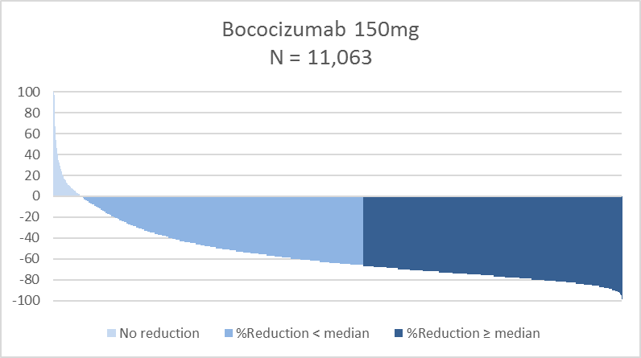
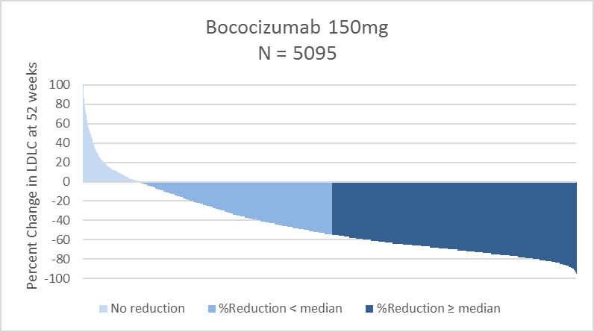
The SPIRE 1 and SPIRE 2 Cardiovascular Outcomes Trials:
Confirmation of Wide Individual Variability in Percent LDLC Reduction
14 weeks
Percent Change in LDLC
52 weeks
Percent Change in LDLC
Ridker ACC 2017

Slide 18
The SPIRE-1 Cardiovascular Outcomes Trial: Baseline LDLC > 70 mg/dL
Primary Pre-Specified Endpoint*
(referent)
Placebo 173 events
Bococizumab 150 mg 173 events
HR 0.99
95%CI 0.80-1.22
P = 0.94
Cumulative proportion with MACE + UARUR
Baseline LDLC 94 mg/dL
Placebo Event Rate 3.02 / 100-person years
Median follow-up 7 months
Weeks
*Nonfatal myocardial infarction, nonfatal stroke, hospitalization for unstable angina requiring urgent
revascularization, or cardiovascular death
Ridker ACC 2017

Slide 19
The SPIRE-2 Cardiovascular Outcomes Trial: Baseline LDLC > 100 mg/dL
Primary Pre-Specified Endpoint*
(referent)
Placebo 224 events
Bococizumab 150 mg 179 events
HR 0.79
95%CI 0.65-0.97
P = 0.021
Cumulative proportion with MACE + UARUR
Baseline LDLC 133 mg/dL
Placebo Event Rate 4.19 / 100-person years
Median follow-up 12 months
Weeks
*Nonfatal myocardial infarction, nonfatal stroke, hospitalization for unstable angina requiring urgent
revascularization, or cardiovascular death
Ridker ACC 2017

Slide 20
The SPIRE 1 and SPIRE 2 Cardiovascular Outcomes Trials: Combined Trials
Primary Endpoint*, Stratified By Magnitude of LDLC Reduction (%)
(referent)
Placebo
Bococizumab 150 mg, < median % LDLC reduction
Bococizumab 150 mg, > median % LDLC reduction
HR 0.94
95%CI 0.77-1.14
P = 0.51
Cumulative proportion with MACE + UARUR
HR 0.75
95%CI 0.61-0.92
P = 0.006
Weeks
*Nonfatal myocardial infarction, nonfatal stroke, hospitalization for unstable angina requiring urgent
revascularization, or cardiovascular death
Ridker ACC 2017

Slide 21
The SPIRE 1 and SPIRE 2 Cardiovascular Outcomes Trials: Combined Trials
Primary Endpoint*, Stratified By Duration of Exposure
Longer Duration of Exposure
(Randomized before median date)
Mean exposure period 13.6 months
Shorter Duration of Exposure
(Randomized after median date)
Mean exposure period 5.6 months
(referent)
Placebo
Bococizumab 150 mg
Placebo
Bococizumab 150 mg
HR 0.83
95%CI 0.70-0.98
P = 0.028
Cumulative proportion with MACE + UARUR
HR 1.03
95%CI 0.78-1.35
P = 0.83
Weeks
Weeks
*Nonfatal myocardial infarction, nonfatal stroke, hospitalization for unstable angina requiring urgent
revascularization, or cardiovascular death
Ridker ACC 2017

Slide 22
The SPIRE-1 and SPIRE-2 Cardiovascular Outcomes Trials :
Incidence Rates of Adverse Events per 100 Person-Years of Exposure
Ridker ACC 2017
Characteristic | Bococizumab (N=13,707) |  |  | Placebo (N=13,697) | Incidence Rate Ratio or Incidence Difference | P-value
 | Overall | Any LDLC <25 mg/dL | No LDLC <25 mg/dL
SAE | 19.5 | 18.2 | 20.5 | 19.7 | 0.99 | 0.84
SAE leading to drug DC | 6.3 | 4.8 | 7.5 | 4.2 | 1.49 | <0.001
Injection Site Reaction | 10.4 | 10.8 | 10.2 | 1.3 | 8.33 | <0.001
Myalgia | 3.7 | 3.1 | 4.3 | 3.4 | 1.09 | 0.22
Diabetes | 4.2 | 4.9 | 3.5 | 4.2 | 0.98 | 0.83
Cataract | 1.1 | 0.9 | 1.3 | 1.1 | 1.00 | 0.97
AST > 3xULN | 0.6 | 05 | 0.7 | 0.6 | -0.08 | 0.59
ALT > 3x ULN | 0.8 | 0.8 | 0.9 | 0.9 | -0.13 | 0.30
CK > 3x ULN | 1.0 | 1.0 | 1.1 | 0.9 | 0.15 | 0.22
Glucose Change- wk 52 (mg/dL) | 4.8 | 4.0 | 5.5 | 3.0 | 1.7 | 0.004
HbA1c Change- wk 52 (%) | 0.09 | 0.07 | 0.10 | 0.06 | 0.02 | 0.11

Slide 23
Conclusions:
The SPIRE Lipid Lowering Trials and the SPIRE 1 and SPIRE 2 Cardiovascular Outcomes Trials
PCSK9 inhibition with bococizumab reduces LDLC by 55 to 60% when given as an adjunct to statin therapy, but this effect is significantly attenuated over time in 10 to 15% of patients due to the development of anti-drug antibodies. This effect is specific to bococizumab (a humanized monoclonal antibody) and has not been seen with either evolocumab or alirocumab (fully human monoclonal antibodies). This immunogenicity also explains the higher rate of injection site reactions observed with bococizumab.
Bococizumab is also associated with wide individual variability in LDLC response even among those who do not develop anti-drug antibodies. This suggests that on-treatment measures of LDLC will be important for clinical practice. Whether similar individual variability in LDLC response is present for evolocumab and alirocumab is uncertain.
Ridker ACC 2017

Slide 24
Conclusions:
The SPIRE Lipid Lowering Trials and the SPIRE 1 and SPIRE 2 Cardiovascular Outcomes Trials
3. Despite anti-drug antibody production, variation in individual response, and early trial termination, bococizumab significantly reduced cardiovascular event rates in the higher-risk SPIRE-2 trial of those with LDLC >100 mg/dL, but not in the lower-risk SPIRE-1 trial of those with LDLC >70 mg/dL.
Consistent with the hypothesis that “lower is better for longer”, clinical benefits were greater and statistically significant in analyses of those who achieved and sustained greater absolute as well as relative reductions in LDLC. These data thus support the use of PCSK9 inhibitors in selected patients as an adjunct to aggressive statin therapy.
Ridker ACC 2017

Slide 25
Conclusions:
The SPIRE Lipid Lowering Trials and the SPIRE 1 and SPIRE 2 Cardiovascular Outcomes Trials
While bococizumab may not be available for clinical use, the public presentation of these data honors the altruism of our 31,887 trial participants and contributes to our understanding of PCSK9 inhibition and cardiovascular health.
In addition to thanking our dedicated investigators and coordinators in 35 countries worldwide, the SPIRE Executive Committee and Steering Committee wishes to give a special thanks to our research colleagues at Pfizer for their exceptional commitment to the rapid and fully transparent presentation of these data.
Ridker ACC 2017

Slide 26
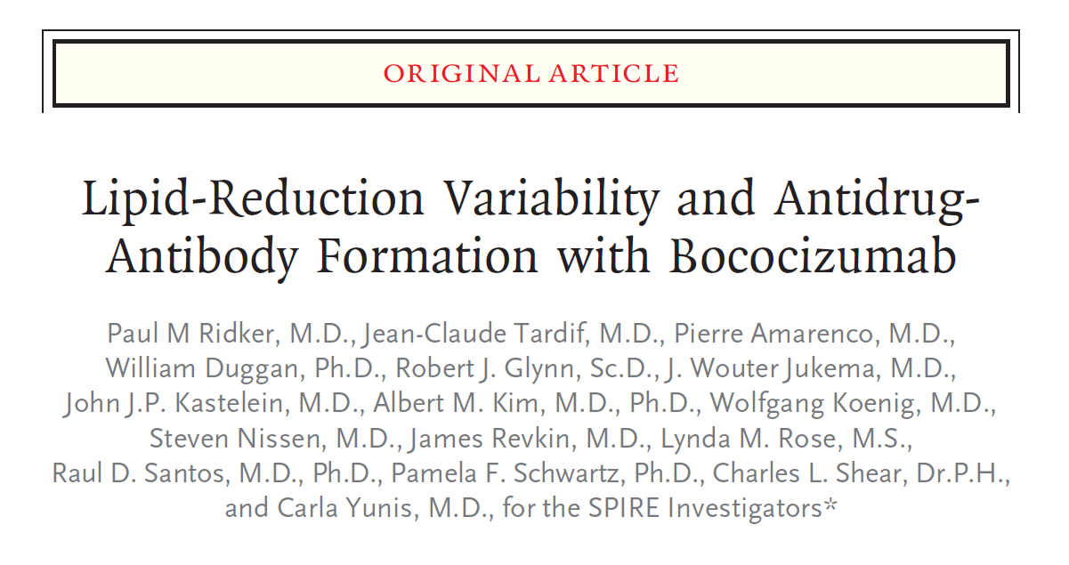
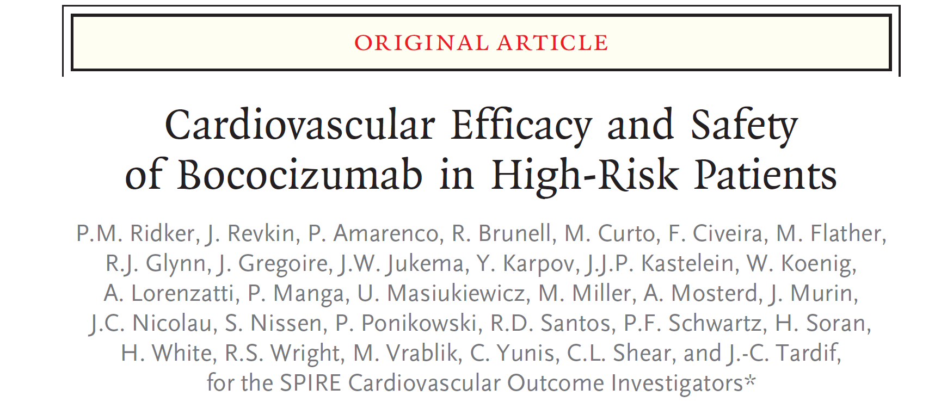
Available online
NEJM March 17, 2017

Slide 27
