Slide 1
Manesh R. Patel, MD on behalf of the
EUCLID Executive and Steering Committee and Investigators
EUCLID Trial Primary Results
Late Breaking Clinical Trial Presentation
American Heart Association 2016
November 13th 2016

Slide 2
Disclosures
Member of Executive Committee: EUCLID trial
Research Support: AstraZeneca, CSL, HeartFlow, Janssen Research & Development, Johnson & Johnson, Maquet, Medtronic, National Heart, Lung, & Blood Institute
Consulting/Advisory Board: AstraZeneca, CSL, Genzyme, Bayer Corporation, Janssen Research & Development, Medtronic, Merck & Co.
EUCLID was sponsored by AstraZeneca

Slide 3
Peripheral Artery Disease of the Lower Extremity
Peripheral artery disease (PAD) is considered a systemic manifestation of atherosclerosis affecting over 200 million people worldwide.¹
PAD is associated with both cardiovascular and limb morbidity and mortality.
Antiplatelet therapy is recommended for all patients with PAD.
¹ Fowkes 382(9901):1329-40.Lancet 2013

Slide 4
Efficacy of Clopidogrel vs. Aspirin for MI,
Ischemic Stroke, or Vascular Death
16
8.7%* P=0.043
Overall relative risk reduction
12
ASA
5.83%
Cumulative event rate (%)
8
5.32%
Clopidogrel
4
N=19,185
0
0
3
6
9
12
15
18
21
24
27
30
33
36
Months of follow-up
ASA=aspirin.
Mean follow-up=1.91 years.
*ITT analysis.
CAPRIE Steering Committee. Lancet. 1996;348:1329-1339.
Notes:
CAPRIE Steering Committee. A randomised, blinded, trial of clopidogrel versus aspirin in patients at risk of ischaemic events (CAPRIE). Lancet. 1996;348:1329-1339.

Slide 5
Background Conclusions
PAD is common with a high risk for cardiovascular (CV) events.
Clopidogrel is superior to aspirin in PAD and indicated.
Ticagrelor is an antiplatelet agent that reduces CV death, myocardial infarction (MI), or stroke compared to clopidogrel in patients with acute coronary syndrome (ACS) and has proven benefits as chronic therapy in patients with prior MI.

Slide 6
Primary Objective — EUCLID
The primary objective of the study is to determine if long-term monotherapy treatment with ticagrelor vs. clopidogrel reduces the rate of the composite of CV death, MI, or ischemic stroke in patients with symptomatic PAD.
First ordered secondary endpoint—primary endpoint plus acute limb ischemia (ALI) requiring hospitalization.

Slide 7
EUCLID Study Design
Patients with symptomatic PAD
Inclusion criteria:
Symptomatic PAD AND one of the following:
A. ABI ≤0.80 at Visit 1 ≤0.85 at Visit 2
OR
B. Prior lower extremity revascularization > 30 days
Key exclusion criteria:
Poor metabolizer for CYP2C19
Patients requiring dual anti-platelet therapy
Ticagrelor
90 mg bid
Double-blind
Double-dummy
Clopidogrel
75 mg od
1:1
N=13,885
Duration: Event Driven Trial
Approximately 14-month recruitment and 26-month follow-up
Primary Endpoint: cardiovascular death, myocardial infarction, or ischemic stroke
Primary Safety Endpoint: TIMI major bleeding
Notes:
Delete follow up and duration – make inclusion and exclusuion easier to see
Put the primary safety endpoint
Tagreted – event driven – how many aimed to get

Slide 8
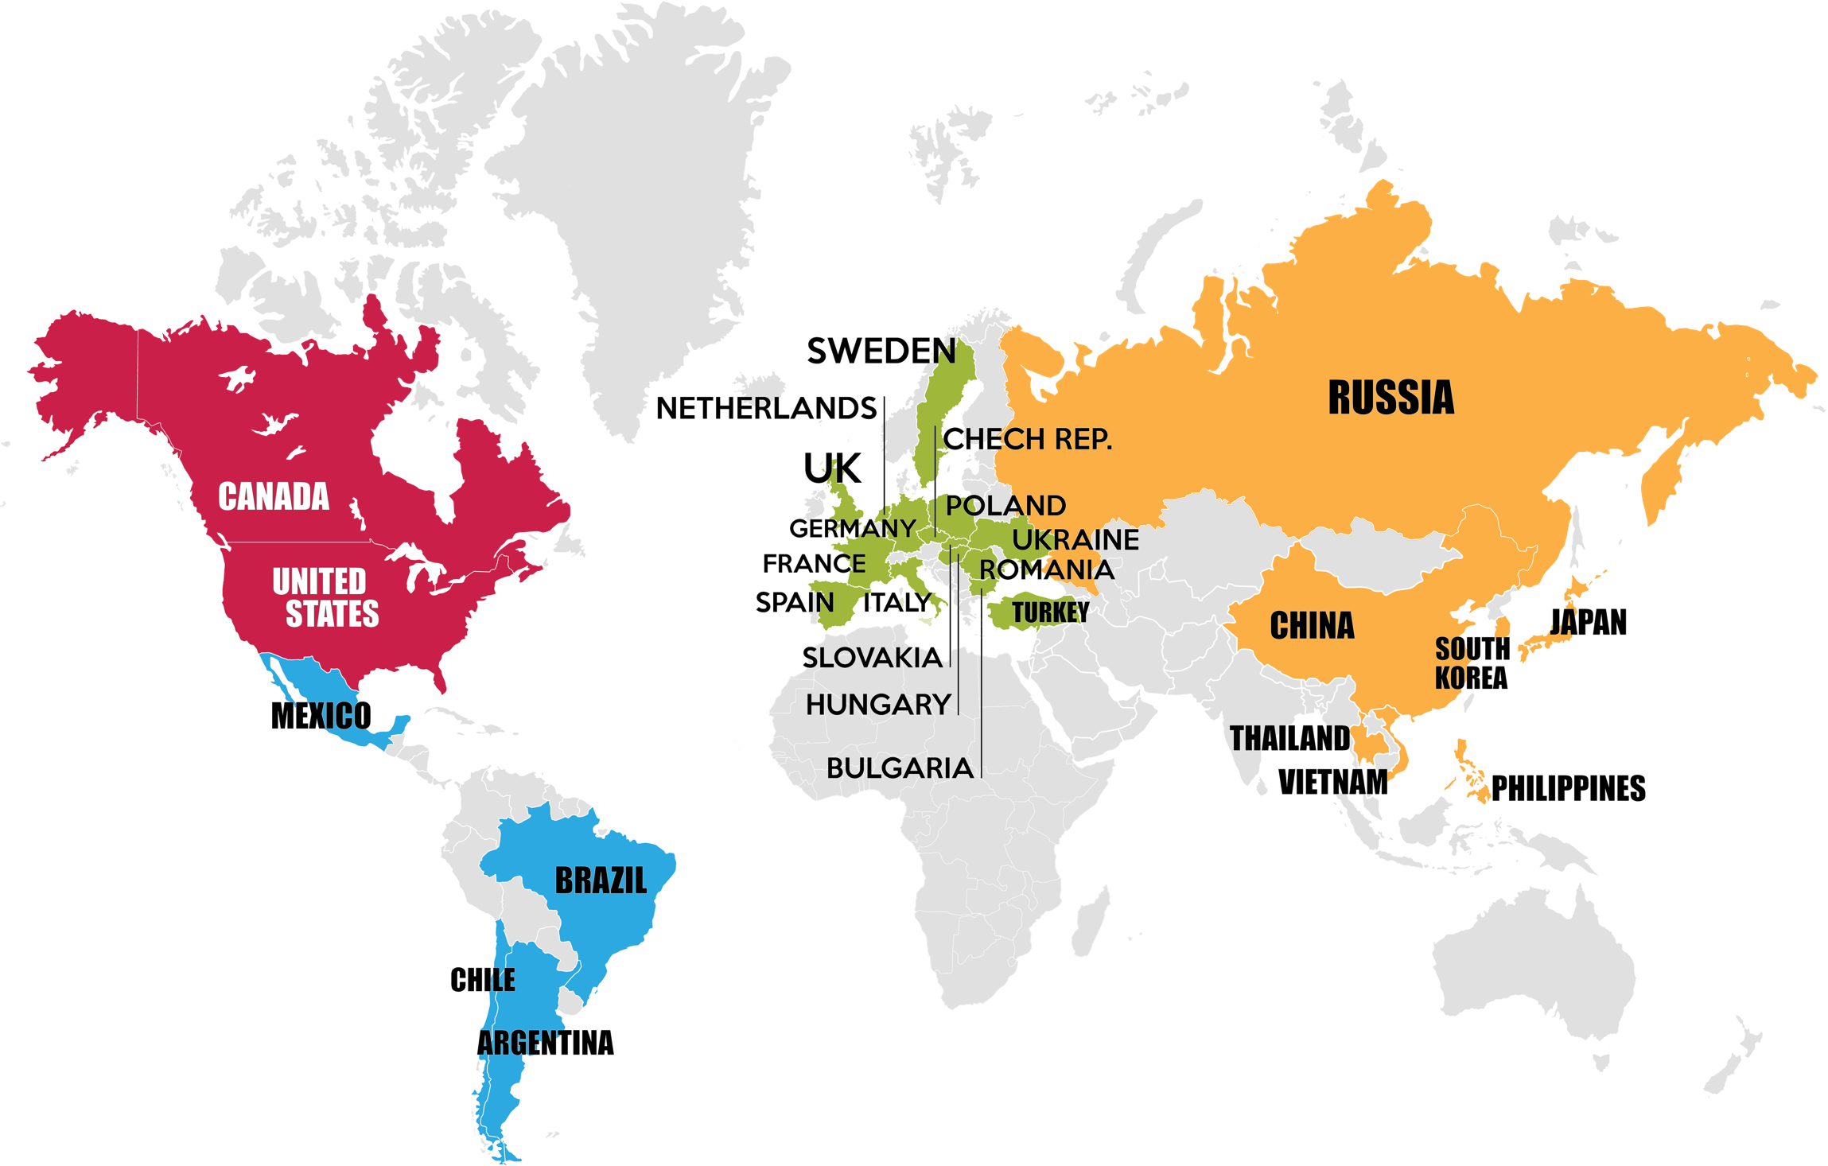
Global Participation
13,855 patients
811 sites
28 countries
EUROPE: 7499 PATIENTS
Bulgaria: 679
Czech Rep: 723
France: 371
Germany: 623
Hungary: 580
Italy: 285
Sweden: 240
Turkey: 137
Ukraine: 536
UK: 297
Netherlands: 234
Poland: 609
Romania: 508
Russian Fed: 935
Slovakia: 419
Spain: 323
NORTH AMERICA:
3044 PATIENTS
US: 2614
Canada: 430
ASIA-PACIFIC:
1602 PATIENTS
China: 423
Japan: 420
Philippines: 128
S. Korea: 214
Thailand: 122
Vietnam: 295
LATIN AMERICA:
1740 PATIENTS
Argentina: 567
Brazil: 643
Chile: 161
Mexico: 369

Slide 9
EUCLID
Patient Follow up
Assessed for eligibility
(n=16,237)
Not randomized (n=2352)
Failed inclusion criteria for symptomatic lower extremity PAD (n=489)
2C19 homozygous (n=616)
Other reasons (n=1335)
Randomized (n=13,885)
Ticagrelor (n=6930)
Never received a dose (n=20)
Allocation
Clopidogrel (n=6955)
Never received a dose (n=23)
Withdrew consent (n=123 [1.8%])
Withdrew consent (n=113 [1.6%])
Discontinued study drug (n=2083 [30.1%])
Discontinued study drug (n=1803 [26.0%])
Unknown vital status (n=7)
Due to withdrawn consent (n=6)
Lost to follow-up (n=1)
Follow-up
Unknown vital status (n=7)
Due to withdrawn consent (n=3)
Lost to follow-up (n=4)
Complete ascertainment of primary endpoint
Proportion of potential a
patient years with follow-up (98.1%)*
Proportion of potential
patient years with follow-up (98.5%)*
*Time from randomization until first primary event, censoring or death, divided by total time until first primary event, death or primary analysis censoring date.

Slide 10
Baseline Characteristics
 | Ticagrelor (N=6930) | Clopidogrel (N=6955)
Age, median, (25th, 75th), years | 66 (60, 72) | 66 (60, 73)
Female sex, no. (%) | 1908 (27.5) | 1980 (28.5)
Weight, median (25th, 75th), kg | 76.4 (66, 88) | 76.5 (66, 88)
Tobacco use, no. (%)
Never smoked | 1481 (21.4) | 1503 (21.6)
Current smoker | 2125 (30.7) | 2164 (31.1)
Former smoker | 3281 (47.3) | 3249 (46.7)

Slide 11
Medical History
 | Ticagrelor (N=6930) | Clopidogrel (N=6955)
History of stroke, no. (%) | 576 (8.3) | 567 (8.2)
History of TIA, no. (%) | 279 (4.0) | 228 (3.3)
CAD||, no. (%) | 2019 (29.1) | 2013 (28.9)
MI, no. (%) | 1242 (17.9) | 1280 (18.4)
Number of vascular beds¶, no. (%)
1 | 3874 (55.9) | 3930 (56.5)
2 | 2333 (33.7) | 2355 (33.9)
3 | 723 (10.4) | 670 (9.6)
Diabetes mellitus (Type I & II), no. (%) | 2639 (38.1) | 2706 (38.9)
Hypertension, no. (%) | 5437 (78.5) | 5420 (77.9)
Hyperlipidemia, no. (%) | 5229 (75.5) | 5251 (75.5)
||CAD is defined as prior MI, prior PCI, or prior CABG.
¶A vascular bed is defined as either PAD, prior CAD (prior MI, prior PCI, or prior CABG), or prior cerebrovascular disease (prior stroke, prior TIA, prior carotid artery stenosis or prior carotid revascularization).
ABI indicates ankle-brachial index; ACE, angiotensin converting enzyme; ARB, angiotensin receptor blocker; CAD, coronary artery disease; MI, myocardial infarction, PAD, peripheral artery disease; SD, standard deviation; TBI, toe-brachial index; TIA, transient ischemic attack.

Slide 12
PAD History—Inclusion Criteria for Randomization
 | Ticagrelor (N=6930) | Clopidogrel (N=6955)
Prior revascularization, no. (%) | 3923 (56.6) | 3952 (56.8)
ABI value, mean (±SD) | 0.78 (±0.23) | 0.78 (±0.23)
ABI/TBI criterion, no. (%)* | 3007 (43.4) | 3003 (43.2)
ABI value, mean (±SD) | 0.63 (±0.15) | 0.63 (±0.15)
TBI value, mean (±SD) | 0.49 (±0.14) | 0.55 (±0.27)
Limb symptoms, no. (%)†
Asymptomatic‡ | 1309 (18.9) | 1292 (18.6)
Mild/moderate claudication | 3674 (53.0) | 3736 (53.7)
Severe claudication | 1620 (23.4) | 1608 (23.1)
Rest pain | 186 (2.7) | 192 (2.8)
Minor tissue loss (ischemic ulceration not exceeding ulcer of the digits of the foot) | 107 (1.5) | 100 (1.4)
Major tissue loss (severe ischemic ulcers or frank gangrene) | 33 (0.5) | 25 (0.4)
Prior major amputation above the ankle, no. (%)§ | 161 (2.3) | 178 (2.6)
*ABI (or TBI) is calculated from site-reported measurements in the CRF, and is calculated as the average of enrollment and randomization ABI (or TBI) measurements, where at each visit, the lowest of the right and left ABIs or (TBIs) is selected. Of those included based on ABI/TBI criteria, 82 (1.2%) patients in the ticagrelor group and 93 (1.3%) in the clopidogrel group were based on TBI criterion.
†Classified using Rutherford classification. Data missing for 1 patient in the ticagrelor group and 2 patients in the clopidogrel group.
‡Symptom status at time of randomization (patients with a prior revascularization may have been asymptomatic at baseline).
§Major amputation included above the knee and transtibial amputations.

Slide 13
Overall Primary Trial Results

Slide 14
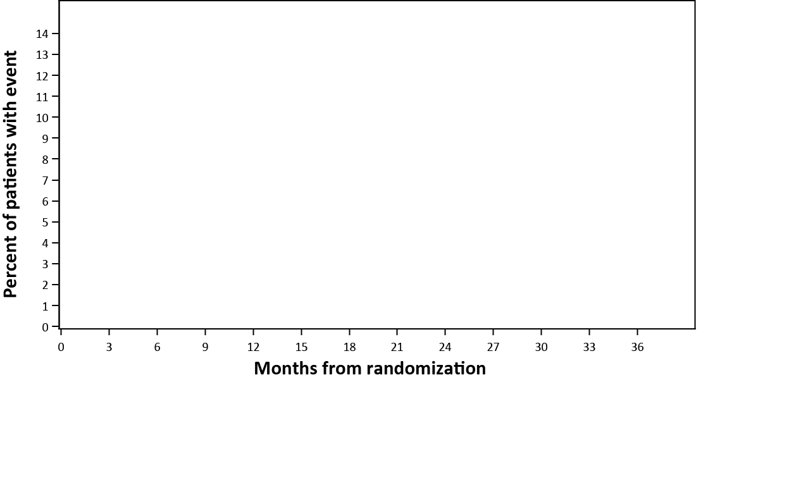
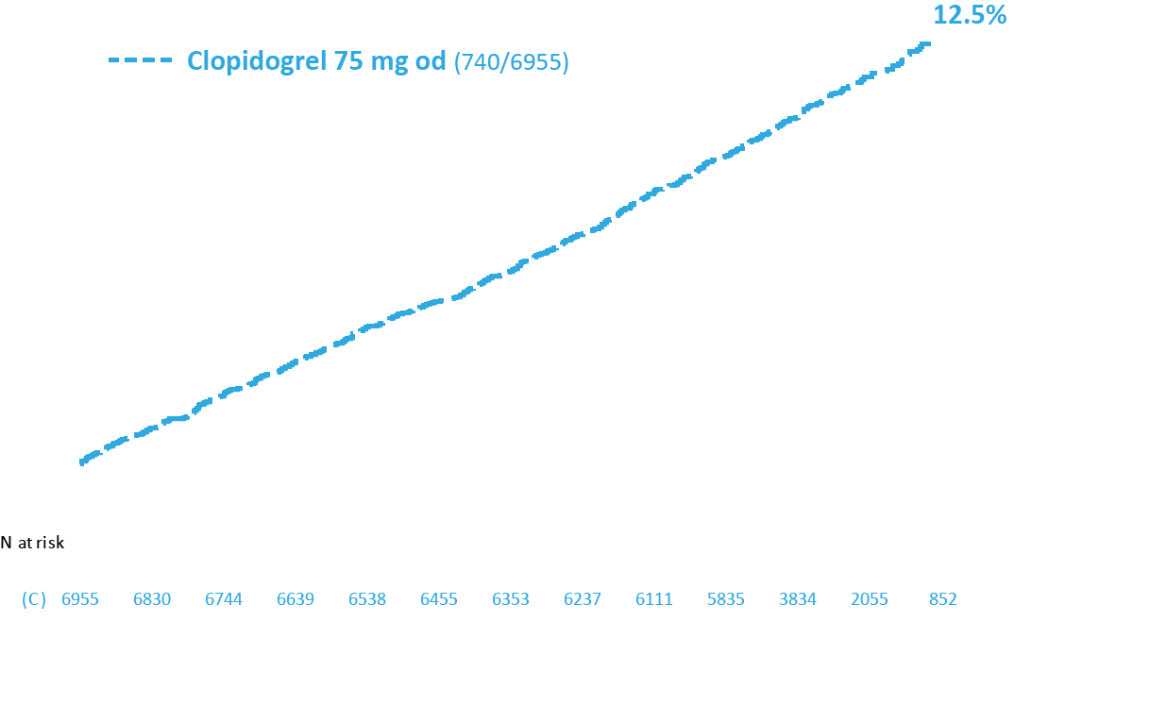
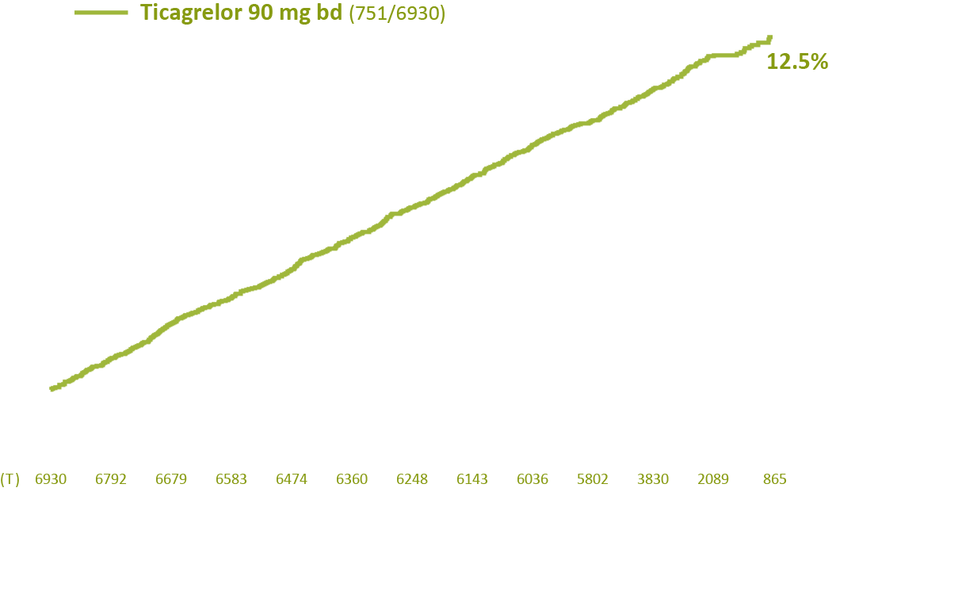
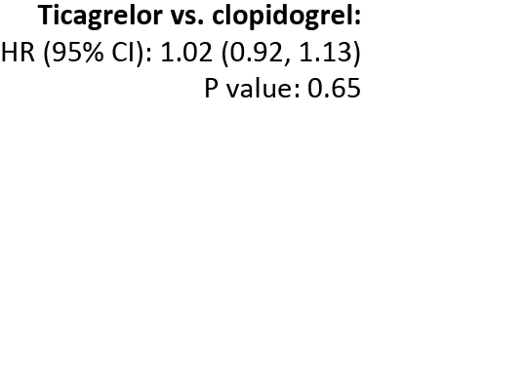
Primary Efficacy Endpoint (CV Death, MI, or Ischemic Stroke)
Notes:
Build – with each arm

Slide 15
Efficacy Outcomes
 | Ticagrelor (N=6930) | Clopidogrel (N=6955) | HR (95% CI) | P Value
Primary outcome: Composite of CV death, MI, or ischemic stroke, no. (%) | 751 (10.8) | 740 (10.6) | 1.02 (0.92–1.13) | 0.65
CV death, no. (%) | 363 (5.2) | 343 (4.9) | 1.07 (0.92–1.23) | 0.40
MI, no. (%) | 349 (5.0) | 334 (4.8) | 1.06 (0.91–1.23) | 0.48
Ischemic stroke, no. (%) | 131 (1.9) | 169 (2.4) | 0.78 (0.62–0.98) | 0.03
Key secondary efficacy outcome: Composite of CV death, MI, ischemic stroke, or ALI requiring hospitalization, no. (%) | 839 (12.1) | 833 (12.0) | 1.02 (0.92–1.12) | 0.74
ALI indicates acute limb ischemia; CI, confidence interval; CV, cardiovascular; HR, hazard ratio; MI, myocardial infarction.

Slide 16
Other Secondary Outcomes
 | Ticagrelor (N=6930) | Clopidogrel (N=6955) | HR (95% CI) | P Value
All-cause mortality, no. (%) | 628 (9.1) | 635 (9.1) | 0.99 (0.89–1.11) | 0.91
Composite of CV death, MI, or all-cause stroke (ischemic or hemorrhagic), no. (%) | 766 (11.1) | 759 (10.9) | 1.02 (0.92–1.13) | 0.72
Hospitalization for ALI, no. (%) | 117 (1.7) | 115 (1.7) | 1.03 (0.79–1.33) | 0.85
Lower extremity revascularization, no. (%) | 846 (12.2) | 892 (12.8) | 0.95 (0.87–1.05) | 0.30
Composite of all revascularizations (coronary and peripheral [limb, mesenteric, renal, carotid, or other]), no. (%) | 1211 (17.5) | 1250 (18.0) | 0.97 (0.90–1.05) | 0.46
ALI indicates acute limb ischemia; CI, confidence interval; CV, cardiovascular; HR, hazard ratio; MI, myocardial infarction.

Slide 17
Safety Outcomes
 | Ticagrelor (N=6910) | Clopidogrel (N=6932) | HR (95% CI) | P Value
Primary safety outcome: TIMI major bleeding, no. (%) | 113 (1.6) | 109 (1.6) | 1.10 (0.84–1.43) | 0.49
Intracranial bleeding | 34 (0.5) | 34 (0.5) | 1.06 (0.66–1.70) | 0.82
Fatal bleeding | 10 (0.1) | 20 (0.3) | 0.53 (0.25–1.13) | 0.10
TIMI minor bleeding, no. (%) | 84 (1.2) | 67 (1.0) | 1.32 (0.96–1.83) | 0.09
Adverse events leading to discontinuation, no. (%) | 1063 (15.4) | 766 (11.1)
Dyspnea leading to discontinuation | 330 (4.8) | 52 (0.8) |  | <0.001
Bleeding leading to discontinuation | 168 (2.4) | 112 (1.6) |  | <0.001
CI indicates confidence interval; HR, hazard ratio; TIMI, Thrombolysis in Myocardial Infarction.

Slide 18
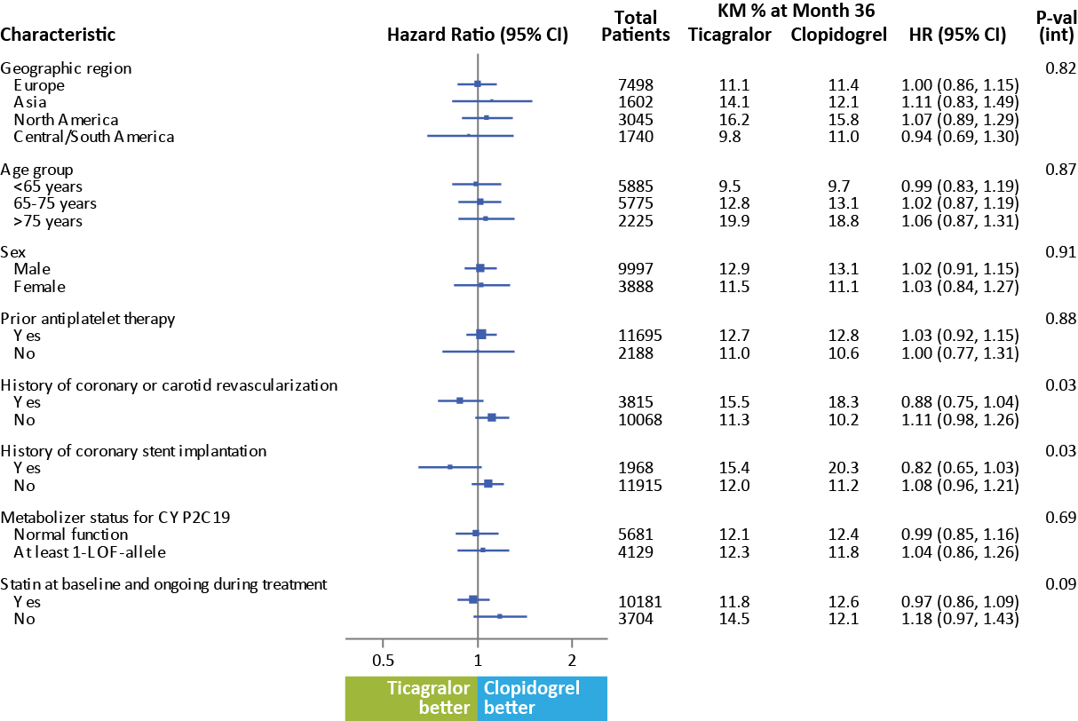
Primary Efficacy Endpoint
Ticagrelor better
Notes:
Statement around safety

Slide 19
Conclusions
In patients with symptomatic peripheral artery disease:
Ticagrelor was not superior to clopidogrel for the reduction of cardiovascular events;
Major bleeding occurred at similar rates in patients treated with ticagrelor and clopidogrel.

Slide 20
Clinical Interpretation and Future Directions
Limited antithrombotic medical options for patients with PAD.
The active comparator in this trial, clopidogrel monotherapy, is effective antiplatelet therapy in PAD.
  Ticagrelor has comparable efficacy and safety
Caution extrapolating evidence from coronary artery disease patients to peripheral artery disease:
  Individual studies in PAD patients are needed.
Notes:
With CV event rates near XX and CV+ALI event rates YY, there remains an

Slide 21
EUCLID Study Committees
Data Monitoring Committee
International Steering Committee
Jonathan L. Halperin (Chair)
Colin Baigent
David DeMets
Ralph Sacco
John Dormandy
Manesh R. Patel (Chair)
Juuso Blomster (Co-chair, 2014–present)
Hakan Emanuelsson (Co-chair, 2012–2014)
Argentina: Fernando Cura, Brazil: Renato D. Lopes, Bulgaria: Nadelin Nikolov, Canada: Beth Abramson, Chile: Juan Carlos Prieto, China: Wang Yuqi,
Czech Republic: Debora Karetova, France: Philippe Lacroix,
Germany: Ulrich Hoffmann, Jan Brunkwall, Hungary: Farkas Katalin,
Italy: Giovanni Di Minno, Japan: Hiroshi Shigematsu, Masato Nakamura,
Mexico: José Luis Leiva Pons, Netherlands: John Kastelein,
Philippines: Fatima Collado, Poland: Arkadiusz Jawień, Romania: Doina Dimulescu, Russia: German Sokurenko, Slovakia: Juraj Maďarič, South Korea: Yang Soo Jang, Spain: Marc Cairols, Sweden: Martin Björck, Thailand: Pramook Mutirangura, Turkey: Kürşat Bozkurt, Ukraine: Sergiy Vasyliuk,
United Kingdom: Andrew Bradbury, United States: Jeffrey Olin, Michael Conte, Christopher White, Alan Hirsch, Vietnam: Dinh Thi Thu Huong
Executive Committee
William R. Hiatt (Chair)
F. Gerry Fowkes (Co-chair)
Iris Baumgartner
Jeffrey S. Berger
Mark Creager (Inactive)
Peter Held (AstraZeneca)
Brian Katona (AstraZeneca)
Kenneth W. Mahaffey
Lars Norgren
Manesh R. Patel
Thank you to the Team and Patients who agreed to participate!

Slide 22
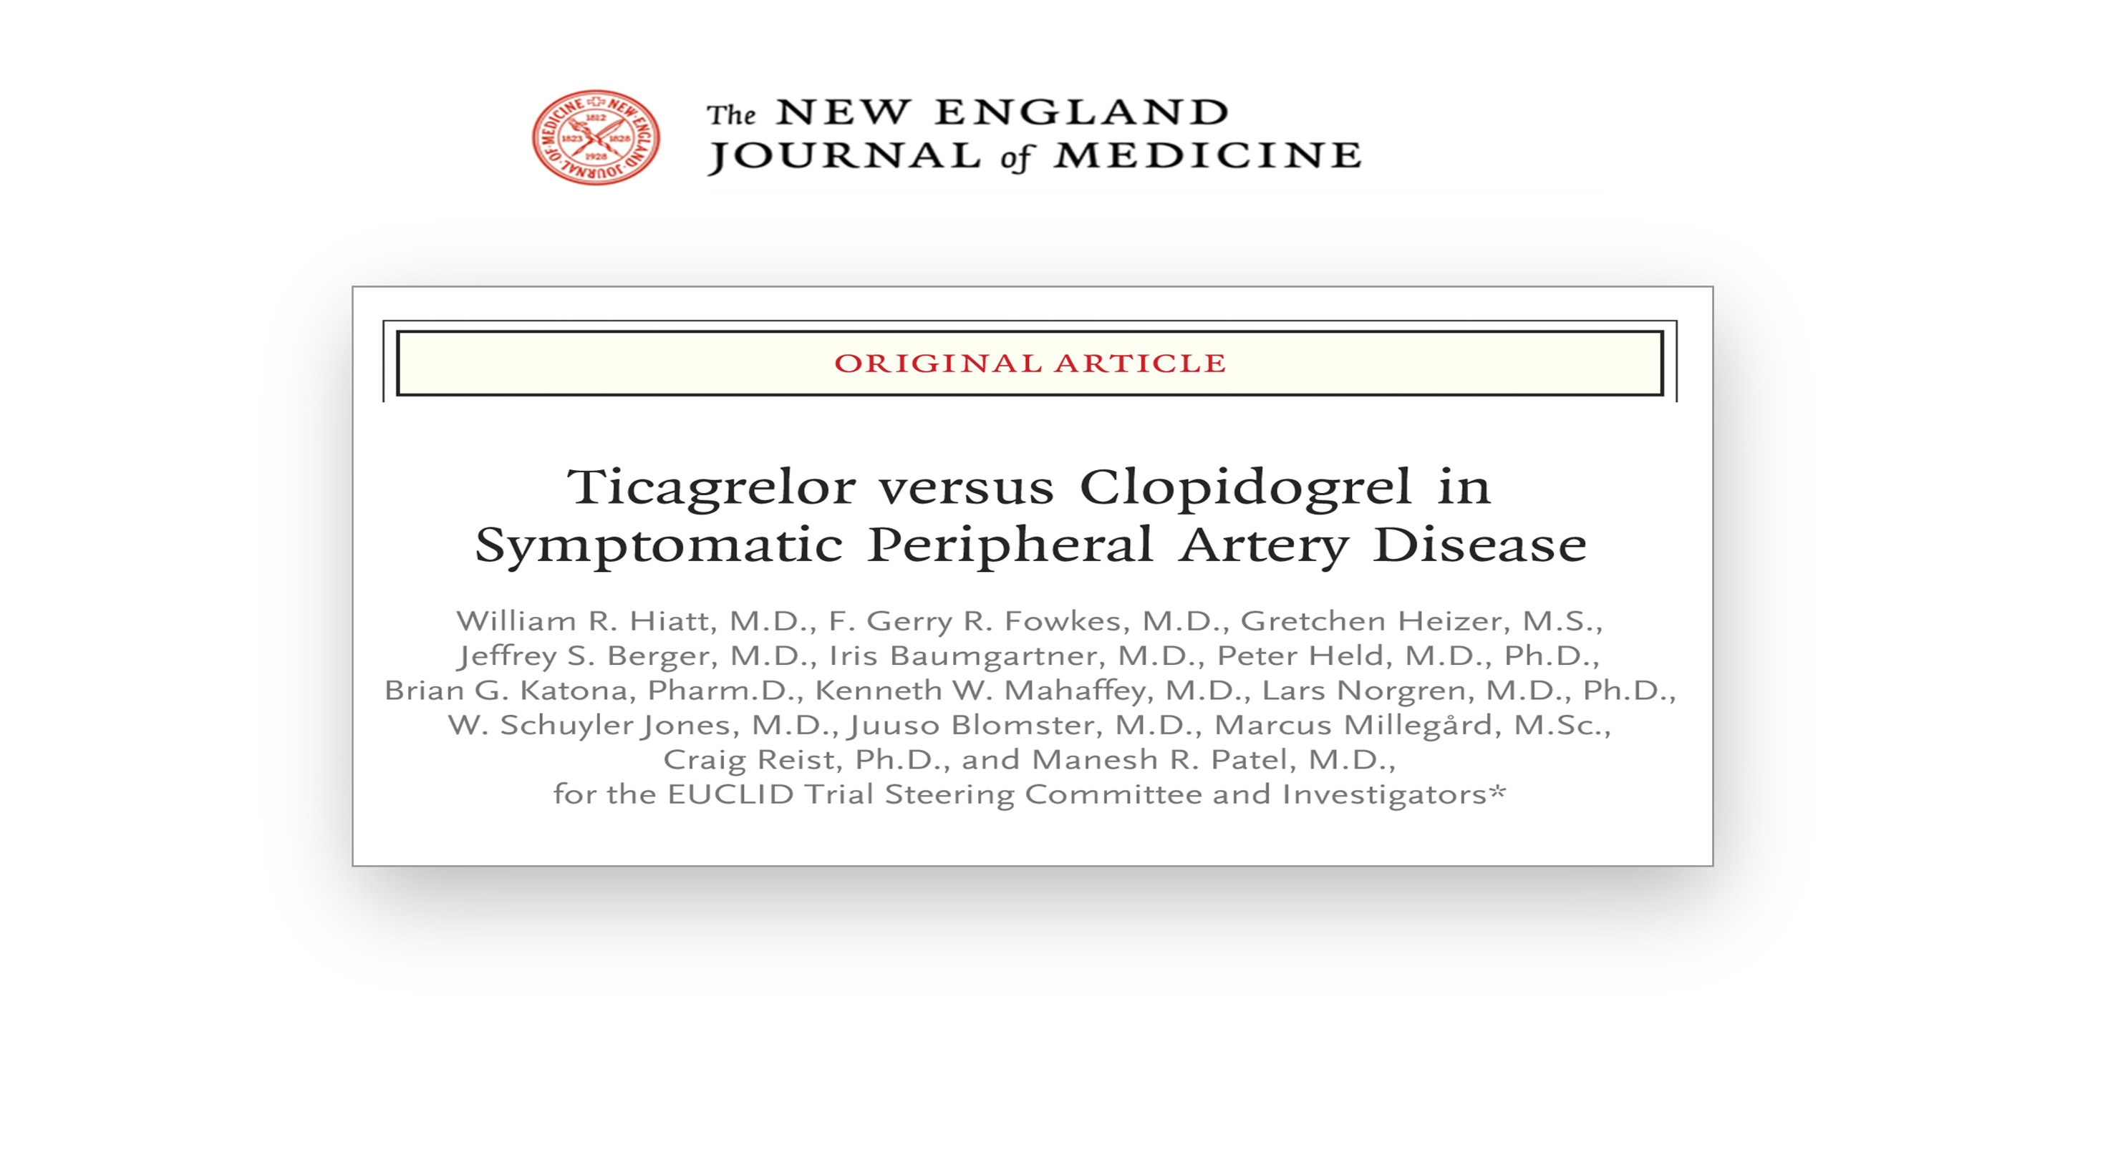

Slide 23
Iris Baumgartner, MD on behalf of the
EUCLID Executive and Steering Committee and Investigators
EUCLID Prior Revascularization Criterion Outcomes
Late Breaking Clinical Trial Presentation
American Heart Association 2016
November 13th 2016
Notes:
Following the main EUCLID presentation I have the honour to follow with results from the prior revascularization criterion subgroup

Slide 24
Disclosures
Member of Executive Committee: EUCLID trial
Research Support: Abbott Vascular, Cook, Optimed, Terumo, Promedics, Amgen, Boston Scientific
Advisory Board: Bayer, AstraZeneca, Sanofi
EUCLID was sponsored by AstraZeneca
Notes:
My disclosures to be shown

Slide 25
Background on PAD revascularization and Anti-platelet therapy
Patients undergoing peripheral revascularization have increased cardiovascular and local event rates early on¹
It remains to be defined whether this continues in a mid-term perspective compared to the overall PAD population
Antithrombotic regimens for long-term management of PAD patients after prior revascularization is not defined^{2,3}
1. J Vasc Surg 64,1009-1017,2016; 2. Circulation 126(4),491-500,2012; 3. Am Heart J 175,86-93,2016
Notes:
Patients undergoing peripheral revascularization have increased cardiovascular and local event rates early on¹
It remains to be defined whether this continues in a mid-term perspective compared to the overall PAD population, giving the rational for the following post hoc subgroup analysis
Antithrombotic regimens for long-term management of PAD patients after prior revascularization is not defined^{2,3}

Slide 26
Efficacy & Safety of Antiplatelet Agents for Prevention of MACE and Leg Amputations in PAD
Systematic Review and Network Meta- Analysis (49 RCT)
surgical & endovascular revascularization
3 RCT (of 49 RCT analysed)
3.527 patients
> 8.000 person-years of follow up
short-term DAPT reduces major amputations after revascularization
Benefit (MACE) - harm (bleeding) profil
*SUCRA cumulative rank probabilities
PLOS ONE 10 (8),1-19,2015
Notes:
Efficacy & Safety of Antiplatelet Agents for Prevention of MACE and Leg Amputations in PAD was recently analyzed in a systematic review and network meta-analysis of available randomized controlled trials (RCT).
Clopidogrel monotherapy showed the most favourable benefit-harm profile. With efficacy on the x and safety on the y axis
In a pooled analysis of 3 RCT on outcome after surgical and/or endovascular revascularuzation with > more than 8,000 person-years of follow-up it was shown that dual antiplatelet therapy with aspirin and Clopidogrel can reduce the rate of major leg amputations following revascularization, but carries a slightly higher risk of severe bleeding.

Slide 27
EUCLID Study Design
Patients with symptomatic PAD
Inclusion criteria:
One of the following:
A. ABI ≤0.80 at Visit 1 ≤0.85 at Visit 2
OR
B. Prior lower extremity revascularization > 30 days
Key exclusion criteria:
Poor metabolizer for CYP2C19
Patients requiring dual anti-platelet therapy
Ticagrelor
90 mg bid
Double-blind
Double-dummy
Clopidogrel
75 mg od
1:1
N=13,885
Duration: Event Driven Trial
Approximately 14-month recruitment and 26-month follow-up
Post hoc Subgroup Analysis
N=7875
Primary Endpoint: cardiovascular death, myocardial infarction, or ischemic stroke
Key Secondary Endpoints: primary composite endpoint plus acute limb ischemia
Primary Safety Endpoint: TIMI major bleeding
Notes:
EUCLID is a double-blind, event-driven clinical trial that randomized 13,885 patients with PAD to treatment with ticagrelor 90 mg twice daily or clopidogrel 75mg daily. Patients were enrolled based on an abnormal ankle-brachial index (ABI) ≤0.80 or a prior lower extremity revascularization. Patients could not be enrolled within 30 days of most recent revascularization, and patients with an indication for dual antiplatelet therapy were excluded.
This post hoc analysis focuses on the 7875 (57%) patients enrolled based on the prior lower extremity revascularization criterion.
The primary efficacy endpoint was time from randomization to first occurrence of any event in the composite of cardiovascular death, myocardial infarction, or ischemic stroke. Key secondary endpoint included the primary composite endpoint plus acute limb ischemia. The primary safety endpoint was Thrombolysis in Myocardial Infarction (TIMI) major bleeding.
The EUCLID trial designed to evaluate treatment specifically in patients with PAD and tested the hypothesis that ticagrelor would be superior to clopidogrel in preventing cardiovascular endpoints in patients with PAD.
The components of the primary efficacy endpoint, the primary safety endpoint, and all hospitalizations for acute limb ischemia were adjudicated by the independent clinical events classification group.

Slide 28
EUCLID
Prior Lower Limb Revascularization (> 30 d) Subgroup Analysis
Is there a mid-term heightened risk for cardiovascular and limb events compared to the population of symptomatic PAD patients with low ABI?
Is more intensive antiplatelet medication more effective and safe over time after prior (> 30 days) revascularization?
Notes:
Two critical questions exist about the long-term prognosis and management of patients who have undergone prior revascularization.
First, are patients with prior lower extremit revascularization at heightened risk for cardiovascular and acute limb events requiring hospitalization when compared with patients who have not undergone prior revascularization?
Second, are more intensive antiplatelet medications more effective yet safe in this population?

Slide 29
First question
a. heightened risk for cardiovascular and limb events
Notes:
Hospitalization for acute limb ischemia was not considered a standard endpoint at the time of protocol development. However, the protocol was amended in December 2013 to collect source data for all hospitalizations for PAD, peripheral revascularization, and amputation. Trained adjudicators then reviewed all information to determine whether patients had acute limb ischemia defined as a hospitalization involving a rapid or sudden decrease in limb perfusion AND either (A) a new pulse deficit, rest pain, pallor, paresthesia, paralysis; OR (B) confirmation of arterial obstruction by limb hemodynamics (ankle or toe pressure) imaging, intra-operative findings, or pathological evaluation.

Slide 30
Baseline Characteristics
Patients with Prior Revascularization According to Treatment Group
 | Prior Revasc. (N=7875) | ABI (N=6010) | P Value | Total EUCLID Pop. (N=13,885)
Age, median (25th, 75th), yrs | 66.0 (60.0,72.0) | 66.0 (61.0,73.0) | <.001 | 66.0 (60.0,73.0)
Female sex, no. (%) | 2129 (27.0) | 1759 (29.3) | 0.004 | 3888 (28.0)
Weight, median (25th, 75th), kg | 76.0 (65.5, 88.0) | 77.0 (67.0, 88.0) | 0.047 | 76.5 (66.0, 88.0)
Medical history, no. (%)
History of stroke | 663 (8.4) | 480 (8.0) | 0.358 | 1143 (8.2)
History of TIA | 309 (3.9) | 198 (3.3) | 0.050 | 507 (3.7)
Prior MI | 1388 (17.6) | 1134 (18.9) | 0.060 | 2522 (18.2)
Prior PCI or CABG | 2070 (26.3) | 1149 (19.1) | <.001 | 3219 (23.2)
Diabetes mellitus, no. (%) | 2834 (36.0) | 2511 (41.8) | <.001 | 5345 (38.5)
Hypertension, no. (%) | 6172 (78.4) | 4685 (78.0) | 0.554 | 10857 (78.2)
Hyperlipidemia, no. (%) | 6206 (78.8) | 4274 (71.1) | <.001 | 10480 (75.5)
Tobacco use, no. (%) |  |  | <.001
Never smoked | 1218 (15.5) | 1766 (29.4) |  | 2984 (21.5)
Current smoker | 2547 (32.3) | 1742 (29.0) |  | 4289 (30.9)
*ABI calculated from site-reported measurements in the CRF, calculated as average of enrollment and randomization ABI (or TBI) measurements (lowest of right and left ABIs (or TBIs)). †Some patients enrolled based on ABI criteria were later noted to have undergone prior revascularization. Since they were enrolled based on this criterion, they were analyzed as part of this group. ABI indicates ankle-brachial index.
Notes:
Baseline characteristics according to treatment group
7875 patients in the prior peripheral revasc group and 6010 in the low ABI group
Patients differed in that there were more females and more diabetics and less previous coronary revasc, hyperlipidemia and smoker in the in the ABI group
Patients had a mean age of 66 years, 73% were male, and the median baseline ABI was 0.78.
When compared with patients enrolled on the ABI criterion, there were fewer females, and had undergone prior PCI or CABG (26.3% vs. 19.1%, p<0.001).
Patients with prior revascularization were less likely to have diabetes but more commonly were current or former smokers and had a higher prevalence of lipid disorders.
Patients with a history of prior revascularization were also more commonly treated with cardio-protective medications including aspirin, clopidogrel, and statins prior to participation in the study, as compared with those enrolled based on the ABI criterion.

Slide 31
Event Rates
Patients Enrolled Based on a History of Prior Revascularization or Abnormal ABI
 | Inclusion Criteria |  | Unadjusted |  | Adjusted
 | Prior revasc. (N=7875) | ABI (N=6010) | HR (95% CI) | P value | HR (95% CI) | P value
Primary efficacy outcome: CV death, MI or ischemic stroke | 894 (11.4%) | 597 (9.9%) | 1.13 (1.02, 1.26) | 0.02 | 1.10 (0.98, 1.23) | 0.12
Cardiovascular death | 372 (4.7%) | 334 (5.6%) | 0.83 (0.72, 0.97) | 0.02 | 0.97 (0.82, 1.14) | 0.58
Myocardial infarction | 466 (5.9%) | 217 (3.6%) | 1.63 (1.38, 1.91) | <0.001 | 1.29 (1.08, 1.55) | 0.005
Ischemic stroke | 176 (2.2%) | 124 (2.1%) | 1.06 (0.85, 1.34) | 0.59 | 0.93 (0.72, 1.20) | 0.58
ALI requiring hospitalization | 196 (2.5%) | 36 (0.6%) | 4.13 (2.90, 5.90) | <0.001 | 4.23 (2.86, 6.25) | <0.001
TIMI major bleeding | 143 (1.8%) | 79 (1.3%) | 1.41 (1.07, 1.85) | 0.01 | 1.28 (0.94, 1.74) | 0.12
Intracranial bleeding | 44 (0.6%) | 24 (0.4%) | 1.42 (0.86, 2.33) | 0.17 | 1.35 (0.76, 2.39) | 0.30
Fatal bleeding | 16 (0.2%) | 14 (0.2%) | 0.89 (0.43, 1.81) | 0.74 | 1.22 (0.54, 2.78) | 0.63
 | Inclusion Criteria |  | Unadjusted |  | Adjusted
 | Prior revasc. (N=7875) | ABI (N=6010) | HR (95% CI) | P value | HR (95% CI) | P value
Primary efficacy outcome: CV death, MI, ischemic stroke | 894 (11.4%) | 597 (9.9%) | 1.13 (1.02, 1.26) | 0.02
Cardiovascular death | 372 (4.7%) | 334 (5.6%) | 0.83 (0.85, 1.34) | 0.02
Myocardial infarction | 466 (5.9%) | 217 (3.6%) | 1.63 (1.38, 1.91) | <0.001
Ischemic stroke | 176 (2.2%) | 124 (2.1%) | 1.06 (0.85, 1.34) | 0.59
Acute limb ischemia requiring hospitalization | 196 (2.5%) | 36 (0.6%) | 4.13 (2.90, 5.90) | <0.001
TIMI major bleeding | 143 (1.8%) | 79 (1.3%) | 1.41 (1.07, 1.85) | 0.01
Intracranial bleeding | 44 (0.6%) | 24 (0.4%) | 1.42 (0.86, 2.33) | 0.17
Fatal bleeding | 16 (0.2%) | 14 (0.2%) | 0.89 (0.43, 1.81) | 0.74
* Risk adjusted for all baseline risk factors: age, sex, weight, region, medical history, tobacco use, and medications at baseline
Notes:
Efficacy Endpoint
When compared with patients enrolled based on the ABI criterion, patients enrolled based on prior revascularization had higher rates of the primary composite endpoint (11.4% vs. 9.9%; HR 1.13, 95% CI 1.02–1.26; p=0.02)
acute limb ischemia (2.5% vs. 0.9%; HR 4.13, 95% CI 2.90–5.90; p<0.001),
and TIMI major bleeding (1.8% vs. 1.3%; HR 1.41, 95% CI 1.07–1.85; p=0.01).
After adjustment for baseline variables, patients enrolled based on prior revascularization had non-statistically significantly higher rates of the primary composite endpoint (HR 0.91, 95% CI 0.81-1.02, p=0.10 ) but statistically significantly higher rates of ALI (HR x.xx, 95% CI x.xx-x.xx, p<0.001).
P-values for differences between baseline characteristics (Table 1 and 2) were calculated using Chi-square (cell size ≥ 5) and Fisher’s exact test (cell size < 5) for categorical variables and Wilcoxon’s test for continuous variables. Adjusted analyses for the primary composite endpoint, its components and ALI (using all variables shown in Table 1) were performed to determine whether those patients entering the study based on prior revascularization had higher rates of cardiovascular and acute limb events when compared with those entering the study based on ABI criteria.

Slide 32
Conclusion: Prior Revascularisation vs Low ABI
After adjustment for baseline characteristics
risk of MI and acute limb events requiring hospitalization remained significantly higher in patients with prior revascularization compared with the ABI subgroup within a median follow up of 30 months
Notes:
Patients with prior lower extremity revascularization had a heightened unadjusted risk of both cardiovascular and acute limb events when compared with patients who entered the study based on the ABI criterion.
After adjustment for baseline characteristics, only risk of acute limb events remained significantly higher in patients with prior revascularization compared with the ABI subgroup while the risk of cardiovascular events was not statistically significant.

Slide 33
Second question
b. is more intensive antiplatelet therapy more effective
and safe over time after revascularization

Slide 34
PAD-specific Baseline Characteristics
Patients with Prior Revascularization According to Treatment Group
 | Ticagrelor (N=3923) | Clopidogrel (N=3952)
ABI values at baseline, median (25th, 75th)* | 0.78 (0.62, 0.94) | 0.78 (0.61, 0.94)
Type of most recent prior revascularization, no. (%)
Surgical | 1443 (36.8) | 1419 (35.9)
Endovascular | 2475 (63.1) | 2528 (64.0)
Time since most recent lower extremity revascularization, no. (%)
>30 days – ≤6 months | 1197 (30.5) | 1256 (31.8)
>6 months – ≤2 years | 1243 (31.7) | 1226 (31.0)
>2 years | 1450 (37.0) | 1442 (36.5)
*ABI is calculated from site-reported measurements in the CRF, and is calculated as the average of enrollment and randomization ABI (or TBI) measurements, where at each visit, the lowest of the right and left ABIs (or TBIs) is selected.
ABI indicates ankle-brachial index; CFA, common femoral artery; SFA, superficial femoral artery.

Slide 35
Efficacy Outcomes
Patients with Prior Revascularization According to Treatment Group
 | Ticagrelor (N=3923) | Clopidogrel (N=3952) | HR (95% CI) | P Value
Primary outcome: CV death, MI, or ischemic stroke, no. (%) | 447 (11.4) | 447 (11.3) | 1.01 (0.88–1.15) | 0.898
CV death, no. (%) | 190 (4.8) | 182 (4.6) | 1.05 (0.86–1.29) | 0.634
MI, no. (%) | 237 (6.0) | 229 (5.8) | 1.05 (0.87–1.25) | 0.629
Ischemic stroke, no. (%) | 76 (1.9) | 100 (2.5) | 0.76 (0.57–1.03) | 0.078
Key secondary efficacy outcome: CV death, MI, ischemic stroke plus ALI requiring hospitalization, no. (%) | 522 (13.3) | 529 (13.4) | 1.00 (0.88–1.12) | 0.947
ALI indicates acute limb ischemia; CI, confidence interval; CV, cardiovascular; HR, hazard ratio; MI, myocardial infarction. Median f-u approximally 30 months

Slide 36
Other Secondary Outcomes
Patients with Prior Revascularization According to Treatment Group
 | Ticagrelor (N=3923) | Clopidogrel (N=3952) | HR (95% CI) | P Value
All-cause mortality, no. (%) | 359 (9.2) | 364 (9.2) | 0.99 (0.86–1.15) | 0.925
Composite of CV death, MI, all-cause stroke (ischemic or hemorrhagic), no. (%) | 456 (11.6) | 461 (11.7) | 1.00 (0.88–1.14) | 0.970
Hospitalization for ALI, no. (%) | 99 (2.5) | 97 (2.5) | 1.03 (0.78–1.36) | 0.835
Lower extremity revascularization, no. (%) | 654 (16.7) | 680 (17.2) | 0.97 (0.87–1.07) | 0.519
Composite of all revascularizations (coronary and peripheral [limb, mesenteric, renal, carotid, or other]), no. (%) | 906 (23.1) | 914 (23.1) | 1.00 (0.91–1.09) | 0.929
ALI indicates acute limb ischemia; CI, confidence interval; CV, cardiovascular; HR, hazard ratio; MI, myocardial infarction.
Notes:
The annualized event rate for acute limb ischemia was 1.01% in the ticagrelor group and 0.99% in the clopidogrel group. Other key secondary and composite endpoints including repeat revascularization were similar between treatment groups

Slide 37
Safety Outcomes
Patients with Prior Revascularization According to Treatment Group
(On-treatment Population)
 | Ticagrelor (N=3911) | Clopidogrel (N=3938) | HR (95% CI) | P Value
Primary safety outcome: TIMI major bleeding, no. (%) | 74 (1.9) | 69 (1.8) | 1.15 (0.83–1.59) | 0.413
Intracranial bleeding | 22 (0.6) | 22 (0.6) | 1.06 (0.59–1.92) | 0.840
Fatal bleeding | 5 (0.1) | 11 (0.3) | 0.49 (0.17–1.40) | 0.180
TIMI minor bleeding, no. (%) | 62 (1.6) | 51 (1.3) | 1.30 (0.89–1.88) | 0.171
CI indicates confidence interval; HR, hazard ratio; TIMI, Thrombolysis in Myocardial Infarction.
Notes:
In patients with a history of prior revascularization, the primary safety endpoint, TIMI major bleeding, occurred in 1.9% of ticagrelor- versus 1.8% of clopidogrel-treated patients (HR 1.15, 95% CI 0.83–1.59; p=0.41). Fatal bleeding, intracranial bleeding, and TIMI minor bleeding were all low frequency events and similar between treatment groups.

Slide 38
Conclusions
A history of prior lower extremity revascularization heightens risk for MI and ALI requiring hospitalization beyond other risk factors
Ticagrelor does not reduce the composite endpoint of MACE and ALI requiring hospitalization when compared with clopidogrel
* MACE major adverse cardiovascular event (cardiovascular mortality, myocardial infarction, ischemic stroke)
Notes:
The main finding of this post hoc subgroup analysis was that acute limb events leading to hospitalization were 4-fold increased in patients with prior lower extremity revascularization when compared with symptomatic patients entering the study based on the ABI criterion. In contrast, although the composite event rates of cv death, MI and stroke was higher in patients with prior lower extremity revascularization as well, statistical significance was lost after adjustment for baseline variables of patients enrolled and despite patients were more commonly treated with cardio-protective medications including aspirin, clopidogrel, and statins prior to participation in the study.

