Slide 1
Reduction in office blood pressure after renal denervation in a large real world patient population with
uncontrolled hypertension:
interim 12-month results from the Global SYMPLICITY Registry
Felix Mahfoud, MD
G. Mancia, M. Schlaich, K. Narkiewicz, L. Ruilope, R. Schmieder, M. Böhm,
on behalf of the GSR Investigators
Saarland University Hospital, Homburg/Saar, Germany

Slide 2
Potential Conflicts of Interest
I have the following potential conflicts of interest to report:
Research Grants
Deutsche Hochdruckliga
Deutsche Gesellschaft für Kardiologie
Saarländisches Ministerium für Wissenschaft und Forschung
Consultant/Lecture fee/Travel support:
Medtronic, St. Jude, Boston Scientific, Cordis, Berlin Chemie, Boehringer Ingelheim
Institutional grant/Research support:
Medtronic, St. Jude, Recor, Boston Scientific

Slide 3
Global SYMPLICITY Registry
Co-Chairs
Prof. Michael Böhm; Prof. Giuseppe Mancia
Executive Committee
Prof. Bryan Williams; Prof. Krzysztof Narkiewicz; Prof. Luis Ruilope; Prof. Markus Schlaich; Dr. Felix Mahfoud
Steering Committee
Executive committee and Dr. Mostafa Adel Youssef; Dr. Ashok Seth; Brett Egan; Dr. Dong-Ju Choi; Dr. Phillip L’Allier Prof. Bert Andersson; Prof. Chaim Lotan; Prof. Iris Baumgartner; Prof. Massimo Volpe; Prof. Roland Schmieder; Prof. Thierry Lefevre; Prof. Uta Hoppe; Prof. Uwe Zeymer; Dr. Robaayah Zambahari
Independent Clinical Events Committee
Steven Marx, MD; Clive Rosendorff, MD, PhD; Michele H. Mokrzycki, MD; Ladan Golestaneh, MD; Joel Neugarten, MD
(Non-voting members: Roxana Mehran, MD and Sorin Brener, MD)
Data Analysis
Institut für Herzinfarktforschung,
IHF, Ludwigshafen, Germany
Sponsor Deutsche Gesellschaft für Kardiologie
Medtronic, Inc.

Slide 4
Background
The Global SYMPLICITY Registry is a prospective, open label, multi-center, international registry designed to assess peri-procedural and long-term safety of RDN in a real world population.
The registry will provide valuable information regarding the effect of RDN on
Blood pressure in hypertensive patients
Conditions characterized by sympathetic overdrive
Differences in patient populations treated with renal denervation
Follow-up results in the first 1,000 enrolled patients for 12 months are now available.

Slide 5
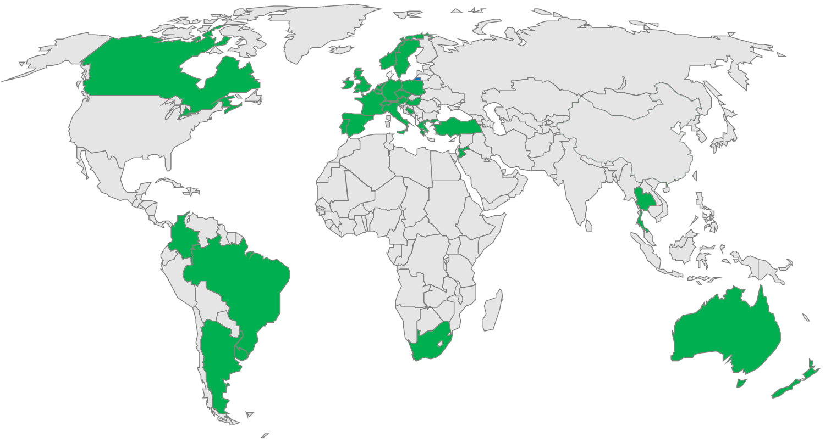
Global SYMPLICITY Registry
CA: 5
Korea: 10
C&EEU: 10
WE: 116
MEA: 11
ASEAN: 10
LA: 6
ANZ: 11
245 international sites in 37 countries
min. 10% randomly assigned to 100% monitoring

Slide 6
Global SYMPLICITY Registry Inclusion criteria
CA: 5
Korea: 10
C&EEU: 10
WE: 116
MEA: 11
ASEAN: 10
LA: 6
ANZ: 11
Uncontrolled hypertension or other conditions associated with increased sympathetic activity
>18 years

Slide 7
Global SYMPLICITY Registry
Consecutive patients treated
in real world population
5000 patients
GREAT Registry
N=1000
Korea Registry
N=102
South Africa Registry
N=400
Canada and
Mexico
Rest of GSR
N~3500
✔
✔
Follow-up
schedule
3M
6M
1Y
2Y
3Y
4Y
5Y
1,000 patients
* Limited to resistant hypertension only
Notes:
7
Comment: The follow-up schedule needs to have an animation that the entire schedule appears later.

Slide 8
Patient Disposition
Baseline (N=1000)
OBP: 989/1000 (98.9%) ABPM: 692/1000 (69.2%)
2 patients died
2 patients withdrew
3 Month Follow-up (N=996) Safety: 984/998 (98.6%)
OBP: 798/996 (80.0%)
ABPM: 485/996 (48.6%)
2 patients died
2 patients withdrew
6 Month Follow-up (N=992) Safety: 969/996 (97.3%)
OBP: 793/992 (79.9%)
ABPM: 526/992 (53.0%)
8 patients died
15 patients withdrew
12 Month Follow-up (N=969) Safety: 862/982 (87.8%)
OBP: 749/969 (77.2%)
ABPM: 390/969 (40.2%)
Analysis on BP change performed on patients with matching baseline and follow-up values

Slide 9
Baseline Patient Characteristics
 | N=1000
Gender, (male) | 61%
Age (years) | 61 ± 12
BMI (kg/m²) | 30 ± 6
Current smoking | 10%
History of cardiac disease | 51%
eGFR <60 ml/min/1.73m² | 23%
Sleep apnea (AHI≥5) | 4%
Diabetes, Type 2 | 39%
1 co-morbidity | 40%
2 co-morbidities | 36%
3+ co-morbidities | 25%

Slide 10
Baseline Patient Characteristics
 | N=1000
Office BP (Systolic/Diastolic), mmHg | 165/89 ± 24/16
24-h BP (Systolic/Diastolic), mmHg | 154/86 ± 18/14
True hypertension | 82%
Masked hypertension | 12%
Pseudo-hypertension | 5%

Slide 11
Baseline Antihypertensive Medication Use
 | N=1000
Antihypertensive medication classes | 4.5 ± 1.3
Beta-blockers | 79%
ACE inhibitors | 34%
ARB | 67%
CCB | 77%
Diuretic | 79%
Aldosterone antagonists | 22%
Spironolactone | 19%
Alpha adrenergic blocker | 35%
Direct-acting vasodilator | 16%
Centrally acting sympatholytics | 35%
Direct renin inhibitor | 8%

Slide 12
S-13
Procedural Details
 | N=1000
Number of renal arteries | 2.2 ± 0.5
Treatment time, min | 50.4 ± 21.6
Number of ablations | 13.5 ± 4.1
Number of 120 sec ablations | 11.4 ± 3.5
Contrast volume used, cc (IQR*) | 127.8 ± 81.1 (70, 160)
*25-75% intra-quartile range

Slide 13
Operator Experience in GSR
189 operators did 1,000 procedures
59% of interventionists performed >15 RDN procedures

Slide 14
Safety at 6 and 12 Months
 | 6 Month n=969 | 12 Month n=862
Composite safety endpoint* | 2.0% | 3.9%
Cardiovascular events
Cardiovascular death* | 0.2% (2) | 0.8% (7)
Stroke | 0.8% (8) | 1.3% (11)
Hospitalization for new onset heart failure | 0.6% (6) | 1.3% (11)
Hospitalization for atrial fibrillation | 0.8% (8) | 1.7% (15)
Hospitalization for hypertensive crisis/hypertensive emergency* | 0.9% (9) | 1.6% (14)
Myocardial infarction | 0.5% (5) | 1.0% (9)
Renal events
New onset end stage renal disease* | 0.2% (3) | 0.4% (3)
Serum creatinine elevation > 50% | 0.4% (4) | 1.0% (9)
New renal artery stenosis >70%* | 0.0% (0) | 0.2% (2)
Post-procedural events
Non-cardiovascular death | 0.2% (2) | 0.5% (4)
Renal artery re-intervention* | 0.2% (2) | 0.4% (3)
Vascular complication* | 0.5% (5) | 0.6% (5)
*included in composite safety endpoint. At 1 month this is defined as Major Adverse Event (MAE) rate
Notes:
MAE rate is 0.91%

Slide 15
Change in Office SBP for All Patients and SBP Subgroups
Baseline Office SBP
All Patients*
<140 mmHg*
140-159 mmHg
160-179 mmHg
≥180 mmHg
n=790
n=784
n=740
n=234
n=231
n=214
n=280
n=286
n=264
n=179
n=166
n=162
n=97
n=101
n=100
*P<0.0001
‡P<0.05
†P=NS
Error Bars=1.96 SE
Baseline SBP (mmHg) | 164 ± 24 | 128 ± 10 | 150 ± 6 | 167 ± 6 | 196 ± 14
*P<0.0001 for both 3 and 6 month change from baseline
†P=0.14 at 3 months and P=0.0006 at 6 months
*85% of patients in this subgroup had masked hypertension (24-h SBP>135 mmHg)

Slide 16
Change in 24-hour SBP for All Patients and Office SBP Subgroups
Baseline Office SBP
All Patients*
<140 mmHg
140-159 mmHg
160-179 mmHg
≥180 mmHg
n=409
n=432
n=390
n=56
n=71
n=62
n=140
n=136
n=130
n=115
n=130
n=117
n=90
n=87
n=73
P<0.01 vs. Baseline for all comparisons
Error Bars= 1.96 SE
*P<0.0001 for both 3 and 6 month change from baseline
†P=0.14 at 3 months and P=0.0006 at 6 months

Slide 17
Change in Office and 24-h SBP for Patients with Baseline SBP <140 mmHg
“Masked hypertension” (24-h SBP>135 mmHg)
Mean 24-hour Ambulatory SBP
Office SBP
P<0.01 for all vs. Baseline
Error Bars= 1.96 SE

Slide 18
Change in Office SBP for HTN3-like Patients
All patients
HTN3-like patients*
n=784
n=740
n=252
n=234
-11.6 ± 24.7
P<0.0001 for all vs. Baseline
Error bars= 1.96 SE
*Baseline office SBP ≥160 mmHg,
mean 24-hr SBP≥135 mmHg,
≥3 antihypertensive drug classes prescribed

Slide 19
Change in 24-h SBP for HTN3-like Patients
All patients HTN3-like patients*
n=432
n=390
n=55
n=64
-7.9 ± 17.5
P<0.0001 for all vs. Baseline
Error bars= 1.96 SE
*Baseline office SBP ≥160 mmHg,
mean 24-hr SBP≥135 mmHg,
≥3 antihypertensive drug classes prescribed

Slide 20
Medication Changes at 12 months
All patients
Increase | 18% (181/986)
Decrease | 25% (250/986)
No change | 56% (550/986)
Not determined | 0.5% (5/986)
HTN3-like patients
Increase | 18% (59/326)
Decrease | 26% (84/326)
No change | 56% (181/326)
Not determined | 0.6% (2/326)

Slide 21
Limitations
Patient selection was at the discretion of enrolling physicians.
As a registry follow-up procedures were not standardized and under-reporting of events is basically possible. However, an independent CEC adjudicated all protocol defined safety events potentially related to RDN.
The subset of Global SYMPLICITY registry patients matching the SYMPLICITY HTN-3 like inclusion was limited to patients in whom the BP inclusion criteria could be positively verified.

Slide 22
Conclusions
In this "real world" patient population, patients demonstrated a substantial reduction in office and ambulatory SBP after RDN, performed by experienced operators, with a favorable safety profile.
Decreases in office and mean 24-hour SBP were greater in the subset of patients meeting the more rigorous SYMPLICITY HTN-3 enrollment criteria.
55.6% of registry patients meeting the SYMPLICITY HTN-3 criteria achieved an office SBP <160 mmHg at 12 months and almost 23% were <140 mmHg within one year of RDN therapy.
RDN therapy resulted in significant reductions in mean 24-hour SBP in the previously undescribed subset of patients with “masked hypertension.”

Slide 23
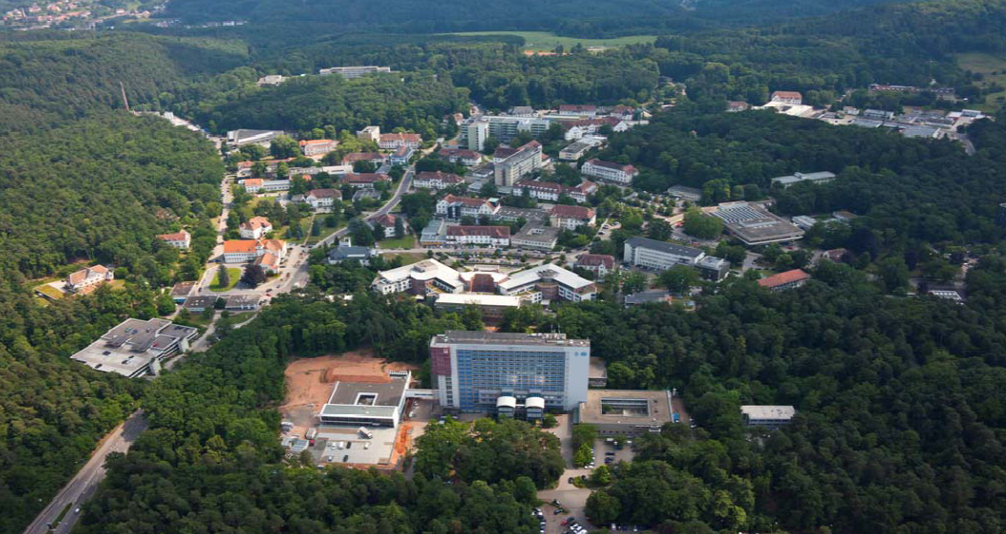
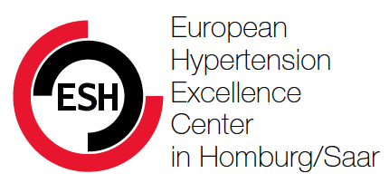
Thank you!
Dr. Felix Mahfoud, MD
Klinik für Innere Medizin III
Universitätsklinikum des Saarlandes
Homburg/Saar, Germany
Tel. 06841-16-21346
Fax. 06841-16-13211
felix.mahfoud@uks.eu

