Slide 1
FOURIER
Further cardiovascular OUtcomes Research with PCSK9 Inhibition in subjects with Elevated Risk
MS Sabatine, RP Giugliano, AC Keech, N Honarpour,
SM Wasserman, PS Sever, and TR Pedersen,
for the FOURIER Steering Committee & Investigators
American College of Cardiology – 66th Annual Scientific Session
Late-Breaking Clinical Trial
March 17, 2017

Slide 2
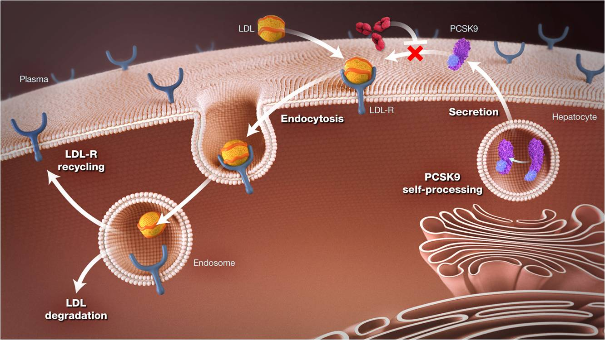
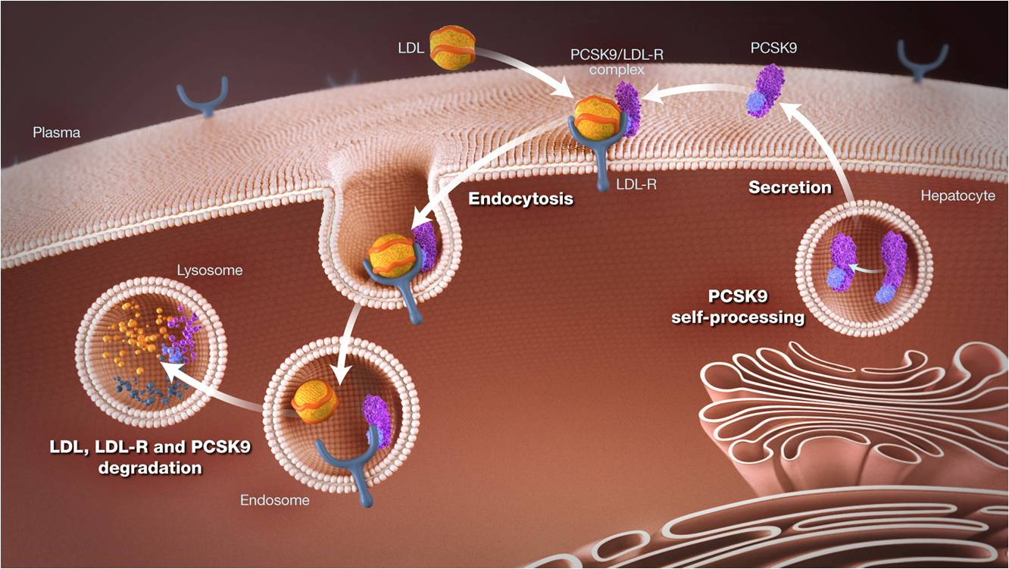
Background
Proprotein convertase subtilisin/kexin type 9 (PCSK9)
  Chaperones LDL-R to destruction → ↑ circulating LDL-C
  Loss-of-fxn genetic variants → ↑ LDL-R → ↓ LDL-C & ↓ risk of MI
evolocumab
Evolocumab
  Fully human anti-PCSK9 mAb
  ~60% ↓ LDL-C
  Safe & well-tolerated in Ph 2 & 3 studies
  Exploratory data suggested ↓ CV events
Sever P & Mackay J. Br J Cardiol 2014;21:91-3
Giugliano RP, et al. Lancet 2012;380:2007-17
Sabatine MS, et al. NEJM 2015;372:1500-9

Slide 3

Objectives
In patients with established cardiovascular disease
on statin therapy:
Test whether the addition of evolocumab reduces the incidence of major cardiovascular events
Examine the long-term safety & tolerability of evolocumab
Investigate the efficacy and safety of achieving unprecedented low levels of LDL-C

Slide 4
Trial Organization
Executive Committee
Marc S. Sabatine (Co-Chair) Terje R. Pedersen (Co-Chair)
Robert P. Giugliano Anthony C. Keech Peter S. Sever
TIMI Study Group
Stephen D. Wiviott (CEC Chair) Cheryl Lowe Leah Zahn
Marc P. Bonaca (Safety Chair) Polly Fish (Director of Ops) Tim Abrahamsen
Sabina Murphy (Director of Stats) Kelly Im (Assoc Dir Stats) Julia Kuder
Estella Kanevsky
Sponsor: Amgen
Scott M. Wasserman Narimon Honarpour Rob Scott
Armando Lira Pineda Kelly Hanlon Beat Knusel
Ransi Somaratne Christopher Kurtz Thomas Liu
Huei Wang
Independent Data Monitoring Committee
Charles H. Hennekens (Chair) Felicita Andreotti Colin Baigent W. Virgil Brown Barry R. Davis John W. Newcomer
Sarah K. Wood
Lipid Monitoring Committee
John LaRosa (Chair) Benjamin Ansell Anders Olsson

Slide 5
Trial Design
27,564 high-risk, stable patients with established CV disease (prior MI, prior stroke, or symptomatic PAD)
Screening, Lipid Stabilization, and Placebo Run-in
High or moderate intensity statin therapy (± ezetimibe)
LDL-C ≥70 mg/dL or
non-HDL-C ≥100 mg/dL
RANDOMIZED
DOUBLE BLIND
Evolocumab SC
140 mg Q2W or 420 mg QM
Placebo SC
Q2W or QM
Follow-up Q 12 weeks
Sabatine MS et al. Am Heart J 2016;173:94-101

Slide 6
Endpoints
Efficacy
  Primary: CV death, MI, stroke, hosp. for UA, or coronary revasc
  Key secondary: CV death, MI or stroke
Safety
  AEs/SAEs
  Events of interest incl. muscle-related, new-onset diabetes, neurocognitive
  Development of anti-evolocumab Ab (binding and neutralizing)
TIMI Clinical Events Committee (CEC)
  Adjudicated all efficacy endpoints & new-onset diabetes
  Members unaware of treatment assignment & lipid levels
Sabatine MS et al. Am Heart J 2016;173:94-101

Slide 7
Steering Committee
Argentina | Estonia | Japan | Singapore
Alberto J. Lorenzatti | Margus Viigimaa | Atsushi Hirayama | Leslie Tay
Australia | Finland | Latvia | Slovakia
John Amerena | Matti J. Tikkanen | Andrejs Erglis | Slavomíra Filipová
Austria | France | Lithuania | South Africa
Kurt Huber | François Schiele | Jolita Badariene | Lesley Burgess
Belgium | Germany | Malaysia | South Korea
André Scheen | Ioanna Gouni-Berthold | Wan A. Wan Ahmad | Donghoon Choi
Brazil | Greece | Mexico | Spain
José F.K. Saraiva | Loukianos Rallidis | G. Gonzalez-Galvez | José López-Miranda
Bulgaria | Hong Kong | Netherlands | Sweden
Borislav G. Georgiev | Chung-Wah Siu | J. Wouter Jukema | Lennart Nilsson
Canada | Hungary | Norway | Switzerland
Lawrence A. Leiter | Kalman Toth | Terje R. Pedersen | François Mach
Chile | Iceland | Philippines | Taiwan
Jorge L. Cobos | Gudmundur Thorgeirsson | Gregorio G. Rogelio | Min-Ji Charng
China | India | Poland | Turkey
Lixin Jiang | P. Deedwania & V. Chopra | Zbigniew A. Gaciong | S. Lale Tokgozoglu
Colombia | Ireland | Portugal | Ukraine
Jose L.A. Mendoza | Brendan McAdam | Jorge Ferreira | Oleg Kraydashenko
Czech Republic | Israel | Romania | United Kingdom
Richard Ceska | Basil S. Lewis | Gheorghe A. Dan | Peter S. Sever
Denmark | Italy | Russia | United States
Henrik K. Jensen | Gaetano M. De Ferrari | Marat V. Ezhov | Robert P. Giugliano

Slide 8
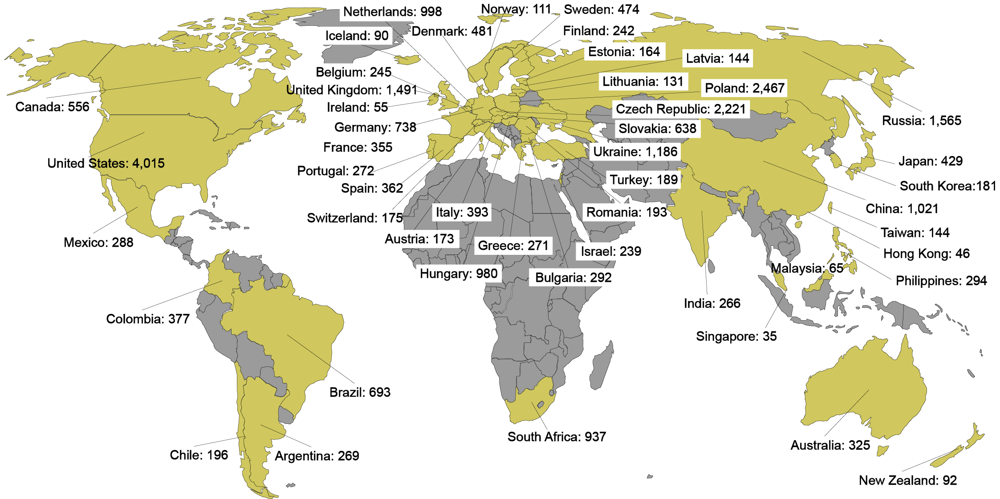

Global Enrollment
27,564 patients randomized at 1242 sites
in 49 countries between 2/2013 – 6/2015
An Academic Research Organization of
Brigham and Women’s Hospital and Harvard Medical School

Slide 9
Follow-up
Randomized 27,564 patients
Evolocumab
(N=13,784)
Placebo
(N=13,780)
Follow-up median 26 months (IQR 22-30)
2907 patients experienced primary endpoint
1829 experienced key secondary endpoint
Premature perm. drug discontinuation | 5.6%/yr | 5.8%/yr
Withdrew consent | 0.29%/yr | 0.35%/yr
Lost to follow-up | 5 patients | 13 patients
Ascertainment for primary endpoint was complete for
99.5% of potential patient-years of follow up

Slide 10
Baseline Characteristics
Characteristic | Value
Age, years, mean (SD) | 63 (9)
Male sex (%) | 75
Type of cardiovascular disease (%)
Myocardial infarction | 81
Stroke (non-hemorrhagic) | 19
Symptomatic PAD | 13
Cardiovascular risk factor (%)
Hypertension | 80
Diabetes mellitus | 37
Current cigarette use | 28
Median time from most recent event ~3 yrs
Pooled data; no differences between treatment arms

Slide 11
Lipid Lowering Therapy
& Lipid Levels at Baseline
Characteristic | Value
Statin use (%)*
High-intensity | 69
Moderate-intensity | 30
Ezetimibe use (%) | 5
Median lipid measures (IQR) – mg/dL
LDL-C | 92 (80-109)
Total cholesterol | 168 (151-189)
HDL-C | 44 (37-53)
Triglycerides | 133 (100-182)
*Per protocol, patients were to be on atorva ≥20 mg/d or equivalent.
1% were on low intensity or intensity data were missing.
Statin intensity defined per ACC/AHA 2013 Cholesterol Guidelines.
Pooled data; no differences between treatment arms

Slide 12
LDL Cholesterol
Placebo
59% mean reduction (95%CI 58-60), P<0.00001
Absolute reduction: 56 mg/dl (95%CI 55-57)
Evolocumab
(median 30 mg/dl, IQR 19-46 mg/dl)

Slide 13
LDL Cholesterol
Placebo
Cohort of 11,077 patients who
had all measurements through 120 weeks
did not discontinue study drug
did not Δ concomitant background lipid-lowering Rx
Evolocumab
Similar data out to 4 years
in OSLER-1
(JAMA Cardiology online)

Slide 14
Primary Endpoint
Hazard ratio 0.85
(95% CI, 0.79-0.92)
P<0.0001
14.6%
Placebo
12.6%
CV Death, MI, Stroke,
Hosp for UA, or Cor Revasc
Evolocumab
0
6
12
18
24
30
36
Months from Randomization

Slide 15
Key Secondary Endpoint
9.9%
Hazard ratio 0.80
(95% CI, 0.73-0.88)
P<0.00001
7.9%
Placebo
CV Death, MI, or Stroke
Evolocumab
0
6
12
18
24
30
36
Months from Randomization

Slide 16
Types of CV Outcomes
Endpoint | Evolocumab (N=13,784) | Placebo (N=13,780) | HR (95% CI)
 | 3-yr Kaplan-Meier rate
CV death, MI, or stroke | 7.9 | 9.9 | 0.80 (0.73-0.88)
Cardiovascular death | 2.5 | 2.4 | 1.05 (0.88-1.25)
Death due to acute MI | 0.26 | 0.32 | 0.84 (0.49-1.42)
Death due to stroke | 0.29 | 0.30 | 0.94 (0.58-1.54)
Other CV death | 1.9 | 1.8 | 1.10 (0.90-1.35)
MI | 4.4 | 6.3 | 0.73 (0.65-0.82)
Stroke | 2.2 | 2.6 | 0.79 (0.66-0.95)

Slide 17
More Intensive LDL-C Lowering
& CV Death
No clear benefit on CV mortality
 |  | # of CV Deaths
Trial | Year | More Intensive Rx Arm | Less Intensive Rx Arm | HR (95% CI)
PROVE-IT TIMI 22 | 2004 | 27 | 36 | 0.74 (0.45-1.22)
A2Z | 2004 | 86 | 111 | 0.76 (0.57-1.01)
TNT | 2005 | 101 | 127 | 0.80 (0.61-1.03)
IDEAL | 2005 | 223 | 218 | 1.03 (0.85-1.24)
SEARCH | 2010 | 565 | 572 | 0.99 (0.88-1.11)
IMPROVE-IT | 2015 | 538 | 537 | 1.00 (0.89-1.13)
Summary |  | 1540 | 1601 | 0.96 (0.90-1.03)
NEJM 2004;350:1495-504
JAMA 2004;292:1307-16
NEJM 2005;352:1425-35
JAMA 2005;294:2437-45
Lancet 2010;376:1658-69
NEJM 2015;372:2387-97
0.2
0.5
1
2
5
More intensive
therapy better
Less intensive
therapy better

Slide 18
Types of CV Outcomes
Endpoint | Evolocumab (N=13,784) | Placebo (N=13,780) | HR (95% CI)
 | 3-yr Kaplan-Meier rate
CVD, MI, stroke, UA, or revasc | 12.6 | 14.6 | 0.85 (0.79-0.92)
CV death, MI, or stroke | 7.9 | 9.9 | 0.80 (0.73-0.88)
Cardiovascular death | 2.5 | 2.4 | 1.05 (0.88-1.25)
MI | 4.4 | 6.3 | 0.73 (0.65-0.82)
Stroke | 2.2 | 2.6 | 0.79 (0.66-0.95)
Hosp for unstable angina | 2.2 | 2.3 | 0.99 (0.82-1.18)
Coronary revasc | 7.0 | 9.2 | 0.78 (0.71-0.86)
Urgent | 3.7 | 5.4 | 0.73 (0.64-0.83)
Elective | 3.9 | 4.6 | 0.83 (0.73-0.95)
Death from any cause | 4.8 | 4.3 | 1.04 (0.91-1.19)

Slide 19
Key Subgroups
Subgroup | Patients
Overall | 27564
Type of disease
MI alone | 19113
Stroke alone | 3366
PAD alone | 1505
Polyvascular disease | 3563
Baseline LDL-C
Q1 (<80 mg/dl) | 6961
Q2 (80-<92 mg/dl) | 6886
Q3 (92-109 mg/dl) | 6887
Q4 (>109 mg/dl) | 6829
Baseline statin intensity
High | 19103
Not high | 8461
Ezetimibe
Yes | 1440
No | 26124
Initial Dosing Regimen
Every 2 weeks | 24774
Monthly | 2790
1° Endpoint HR (95% CI)
Key 2° Endpoint HR (95% CI)
All P_{interactions} NS
0.4
1.0
2.5
0.4
1.0
2.5
EvoMab better
Pbo better
EvoMab better
Pbo better

Slide 20
Lower LDL-C Is Better
Patients divided by quartile of baseline LDL-C and by treatment arm
P<0.0001
Q4
Q3
Q2
Q4
Q3
Q1
Q1
Q2
Placebo
Evolocumab

Slide 21
Landmark Analysis
16% RRR
HR 0.84 (95%CI 0.74-0.96)
P=0.008
25% RRR
HR 0.75 (95%CI 0.66-0.85)
P<0.00001
CV Death, MI, Stroke
Placebo
Evolocumab
0
3
6
9
12
12
18
24
30
36
Months from Randomization

Slide 22
Fatal or Nonfatal MI or Stroke
19% RRR
HR 0.81 (95%CI 0.70-0.93)
P=0.003
33% RRR
HR 0.67 (95%CI 0.59-0.77)
P<0.00001
Fatal or Nonfatal MI or Stroke
Placebo
Evolocumab
0
3
6
9
12
12
18
24
30
36
Months from Randomization

Slide 23
Comparison to Cholesterol Treatment Trialists Collaboration
Hazard Ratio (95% CI) per 1 mmol/L reduction in LDL-C
Major Coronary Events
0.78 (0.70-0.86)
Stroke
0.77 (0.66-0.91)
CTTC Meta-analysis Year 2
Coronary revascularization
0.75 (0.67-0.84)
Major Vascular Events
0.77 (0.73-0.82)
0.5
1.0
2.0
Lipid-lowering therapy better
Lipid-lowering therapy worse
CTTC data from Lancet 2010;376:1670-81

Slide 24
Comparison to Cholesterol Treatment Trialists Collaboration
Hazard Ratio (95% CI) per 1 mmol/L reduction in LDL-C
Major Coronary Events
0.78 (0.70-0.86)
0.80 (0.71-0.90)
Stroke
0.77 (0.66-0.91)
0.77 (0.63-0.94)
CTTC Meta-analysis Year 2
FOURIER Year 2
Coronary revascularization
0.75 (0.67-0.84)
0.73 (0.62-0.86)
0.84 (0.73-0.98)
Urgent
Elective
Major Vascular Events
0.77 (0.73-0.82)
0.83 (0.76-0.90)
0.5
1.0
2.0
Lipid-lowering therapy better
Lipid-lowering therapy worse
CTTC data from Lancet 2010;376:1670-81

Slide 25
Safety
 | Evolocumab (N=13,769) | Placebo (N=13,756)
Adverse events (%)
Any | 77.4 | 77.4
Serious | 24.8 | 24.7
Allergic reaction | 3.1 | 2.9
Injection-site reaction | 2.1 | 1.6
Treatment-related and led to d/c of study drug | 1.6 | 1.5
Muscle-related | 5.0 | 4.8
Cataract | 1.7 | 1.8
Diabetes (new-onset) | 8.1 | 7.7
Neurocognitive | 1.6 | 1.5
Laboratory results (%)
Binding Ab | 0.3 | n/a
Neutralizing Ab | none | n/a
New-onset diabetes assessed in patients without diabetes at baseline; adjudicated by CEC

Slide 26
Summary for Evolocumab
↓ LDL-C by 59%
  Consistent throughout duration of trial
  Median achieved LDL-C of 30 mg/dl (IQR 19-46 mg/dl)
↓ CV outcomes in patients already on statin therapy
  15% ↓ broad primary endpoint; 20% ↓ CV death, MI, or stroke
  Consistent benefit, incl. in those on high-intensity statin, low LDL-C
  25% reduction in CV death, MI, or stroke after 1st year
  Long-term benefits consistent w/ statins per mmol/L ↓ LDL-C
Safe and well-tolerated
  Similar rates of AEs, incl DM & neurocog events w/ EvoMab & pbo
  Rates of EvoMab discontinuation low and no greater than pbo
  No neutralizing antibodies developed

Slide 27
Conclusions
In patients with known cardiovascular disease:
PCSK9 inhibition with evolocumab significantly & safely ↓ major cardiovascular events when added to statin therapy
Benefit was achieved with lowering LDL cholesterol well below current targets

Slide 28

Further Details
Article available at www.nejm.org
Slides available at www.TIMI.org

